Slide 1
SystmOne Medical Examiner
Training
(GP Practice)
.
NWL Primary Care System Facilitation Team
NHS North West London

Slide 2
Today’s Objective
Objective
By the end of this training session, you will be able to do the following:
Activating NWL medical examiner sharing
Send medical examiner referral
Receiving tasks from the medical examiner in workflow

Slide 3
Activating NWL Medical Examiner Sharing Agreement
Set up
User & Policy
Share In Rules
Add organisation
In the search box type North West London Medical Examiner - select search.
Click on the rectangle box and select okay.

Slide 4
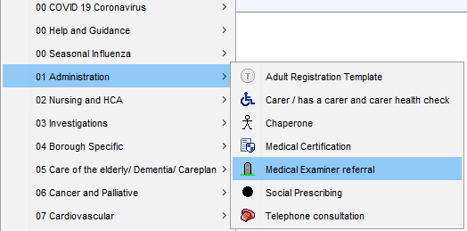
Send medical examiner referral
Open the record of the patient you wish to refer to the service. Launch the referral template from Auto-Consultation > 01 Administration > Medical Examiner referral

Slide 5
Send medical examiner referral

Slide 6
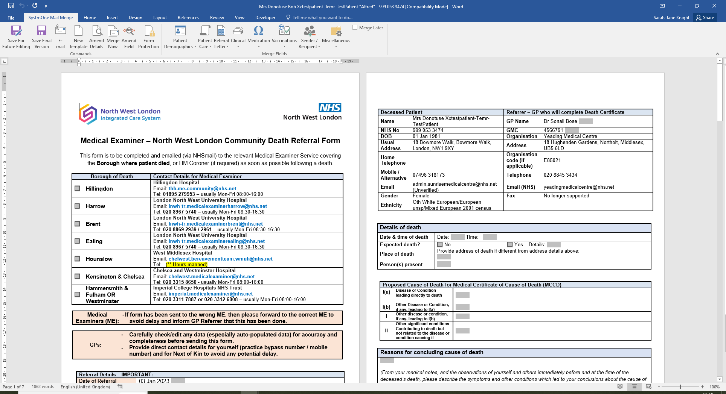
Sending Referral Form

Slide 7
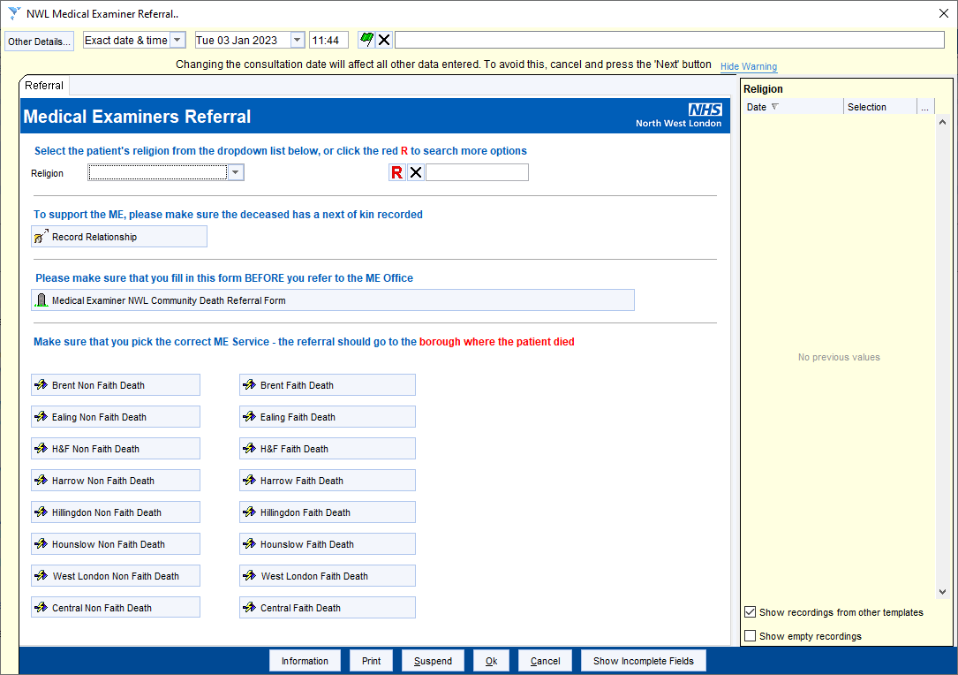
Sending Referral Form
Choose the ME service you wish to refer to from the list, depending on whether the patient requires an expedited referral (24hrs faith death) and in which North West London borough the patient died.

Slide 8
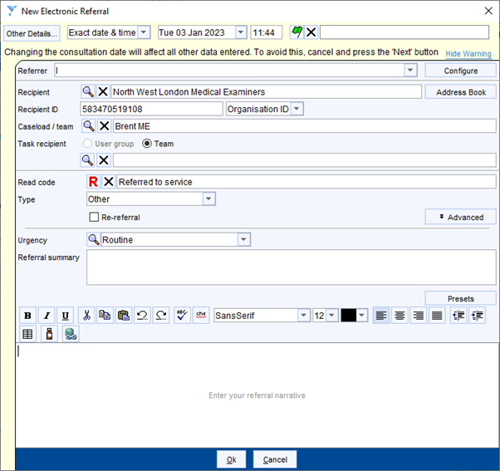
Sending Referral Form
The recipient information will now appear. Most of the information is pre-populated. Add in a short reason for referral at the bottom of the screen (this will be the first display when the Medical Examiner views your referral) and a referral summary for your own information, if needed (this displays in the patient’s Tabbed Journal).
SAVE the record to complete the referral and send electronically to the relevant Medical Examiner team.

Slide 9
Thank you for your attendance and participation in this training session

