Slide 1


Slide 2
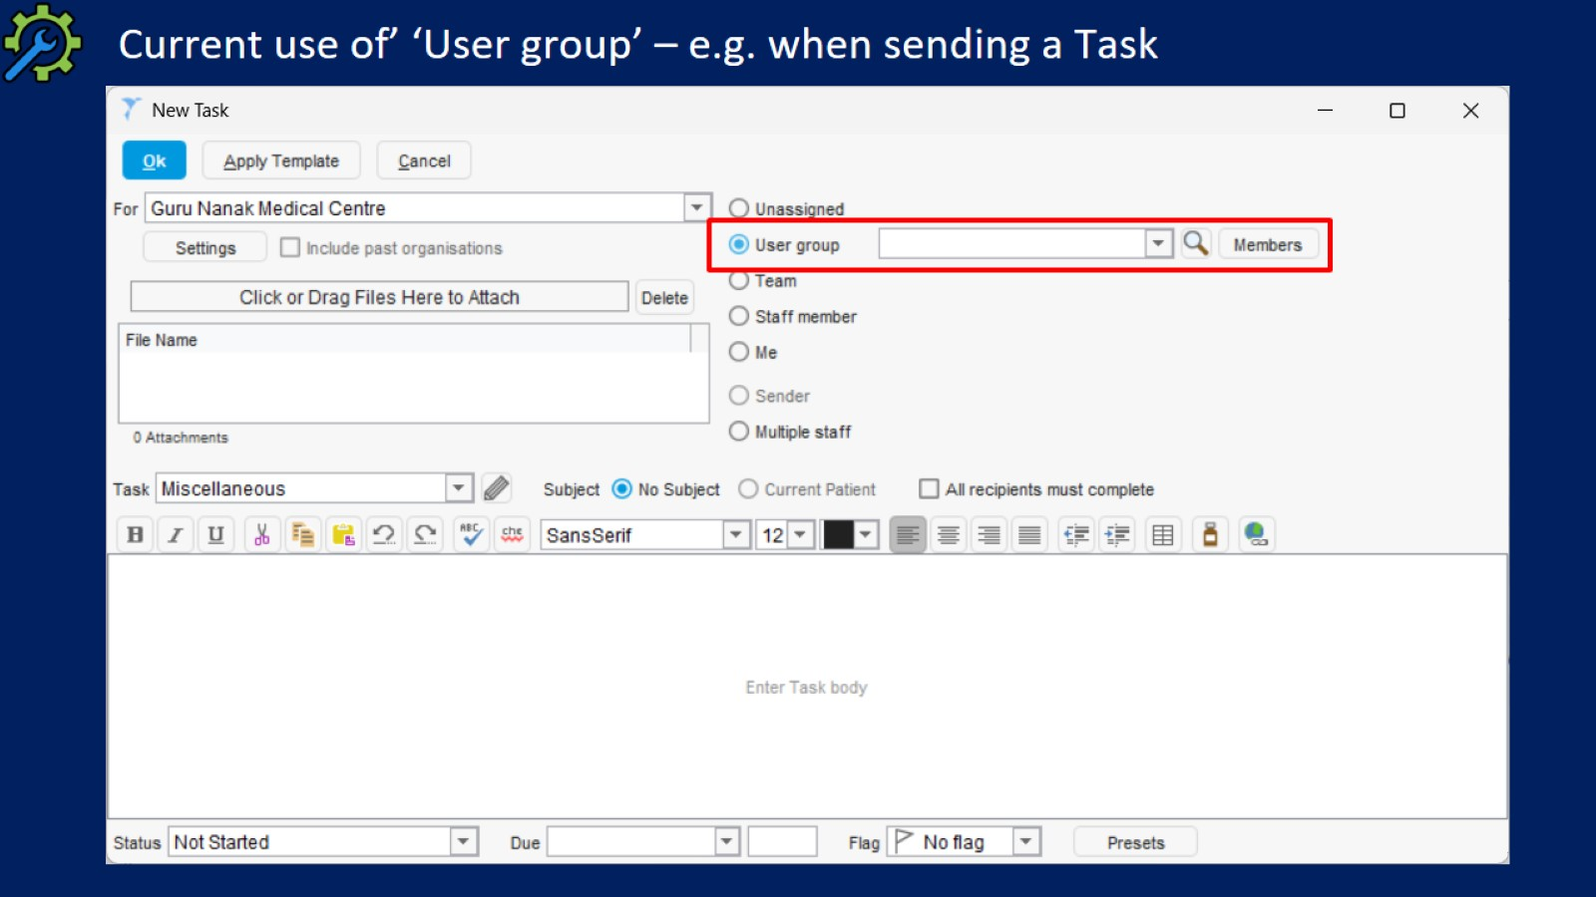
Current use of’ ‘User group’ – e.g. when sending a Task

Slide 3
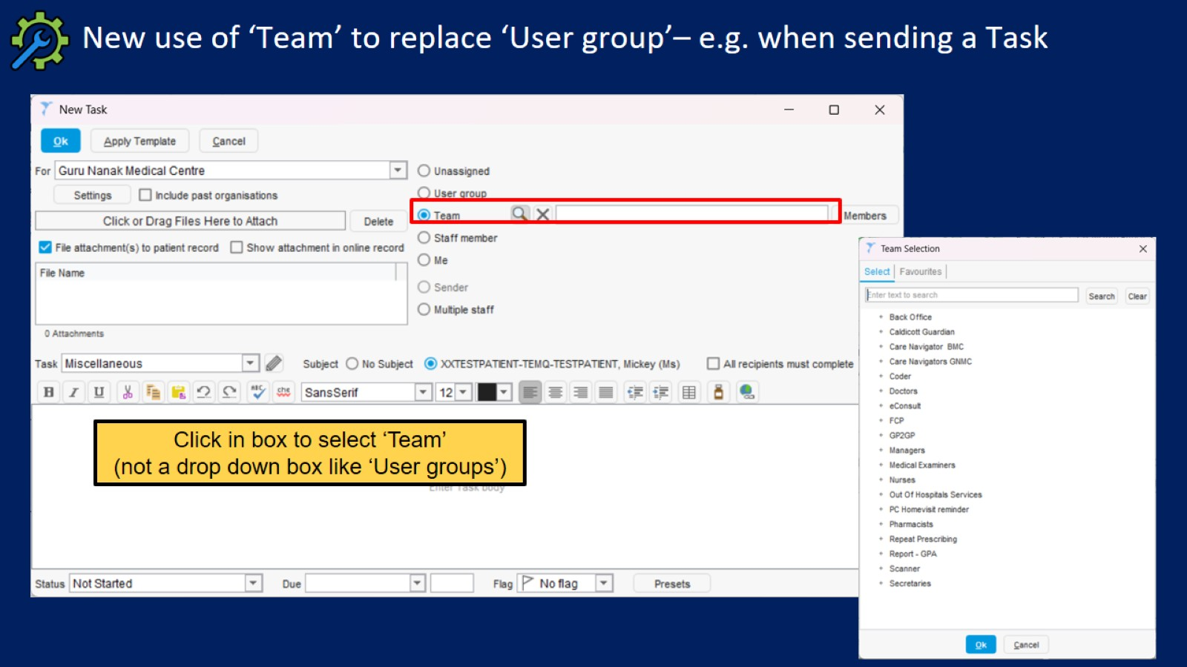
New use of ‘Team’ to replace ‘User group’– e.g. when sending a Task

Slide 4
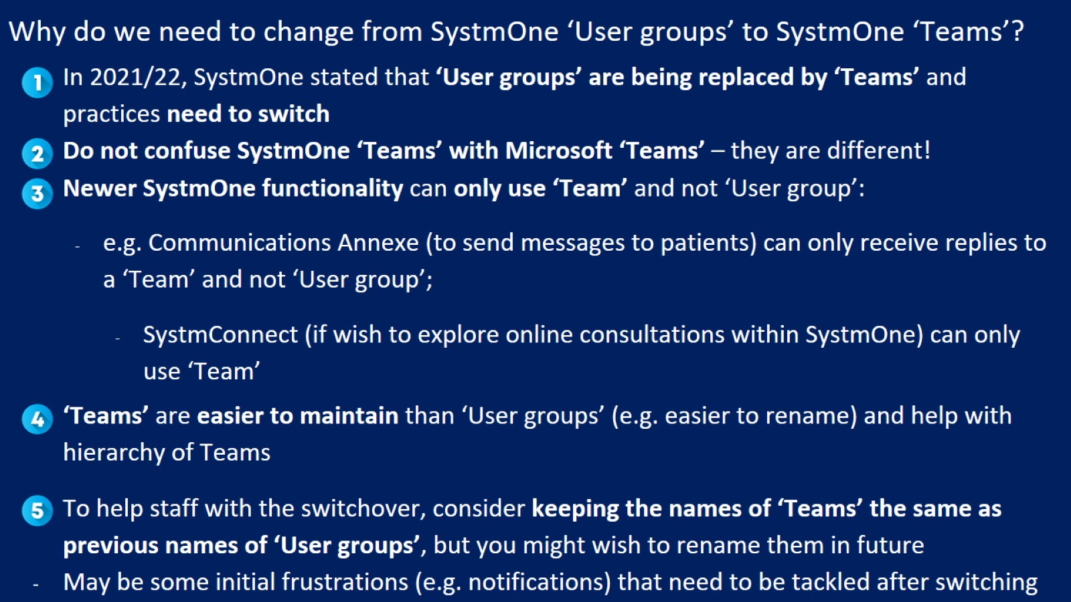
Why do we need to change from SystmOne ‘User groups’ to SystmOne ‘Teams’?

Slide 5
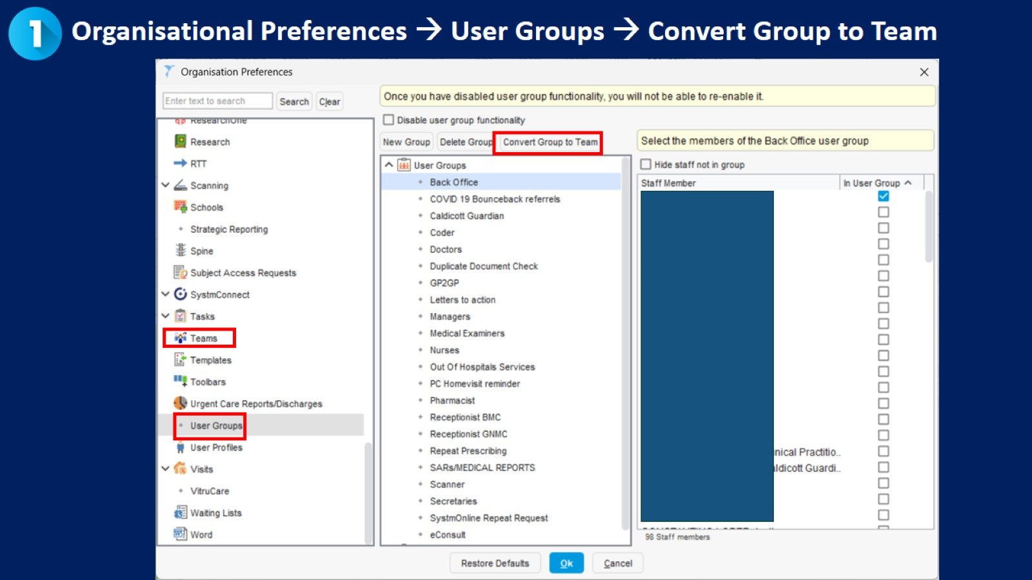

Slide 6
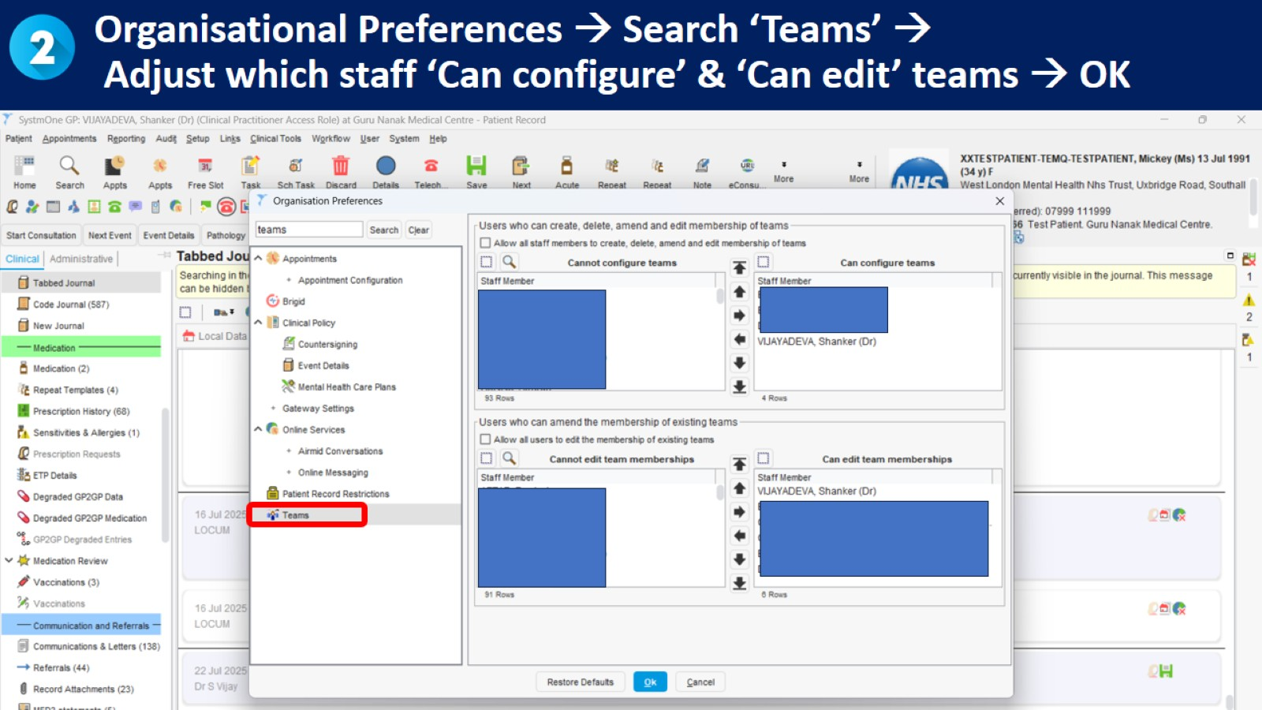
Organisational Preferences → Search ‘Teams’ →
Adjust which staff ‘Can configure’ & ‘Can edit’ teams → OK

Slide 7
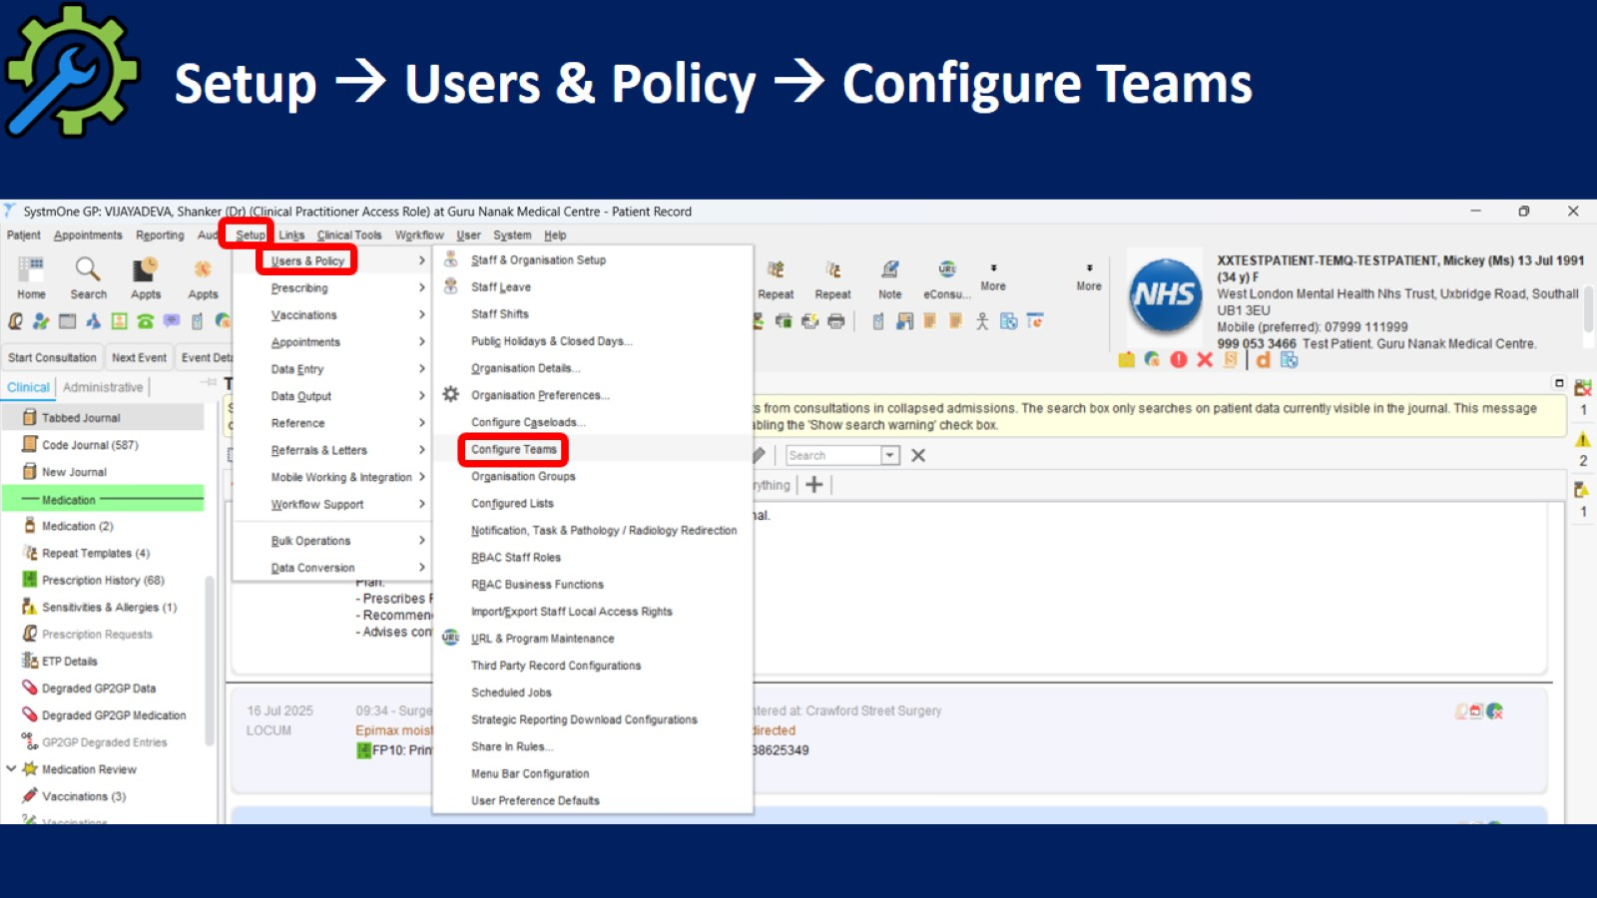
Setup → Users & Policy → Configure Teams

Slide 8
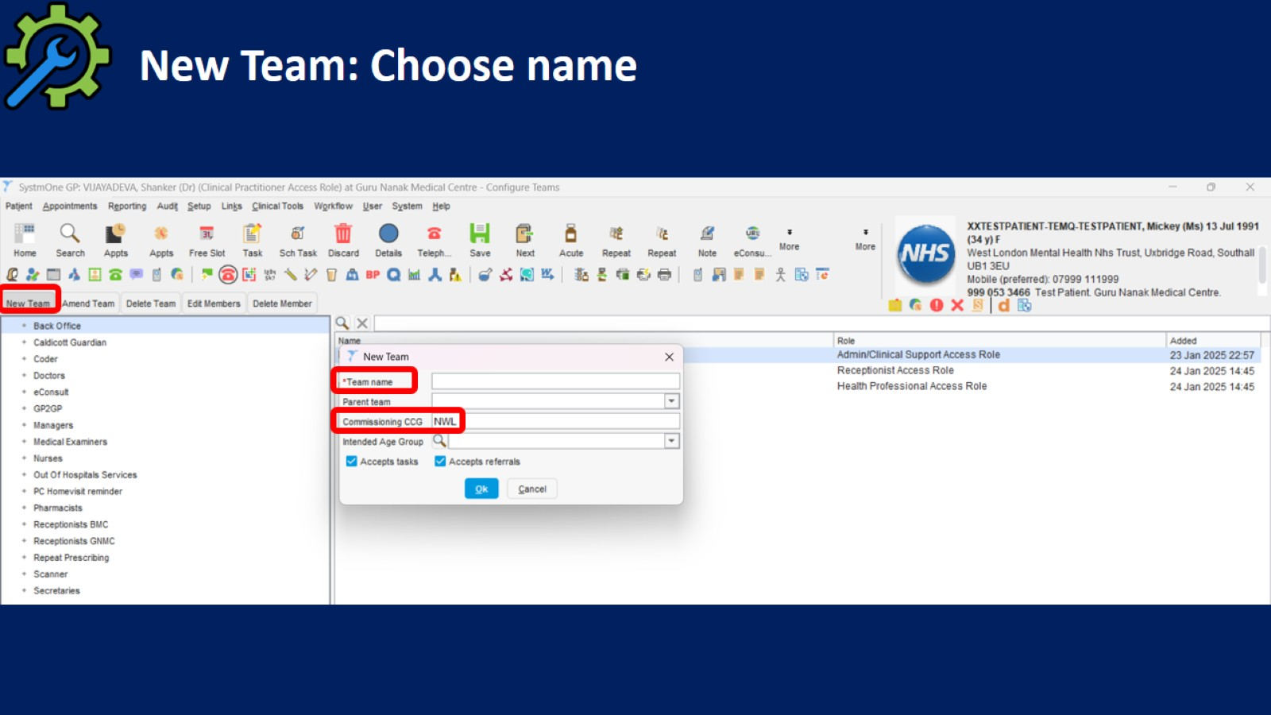
New Team: Choose name

Slide 9
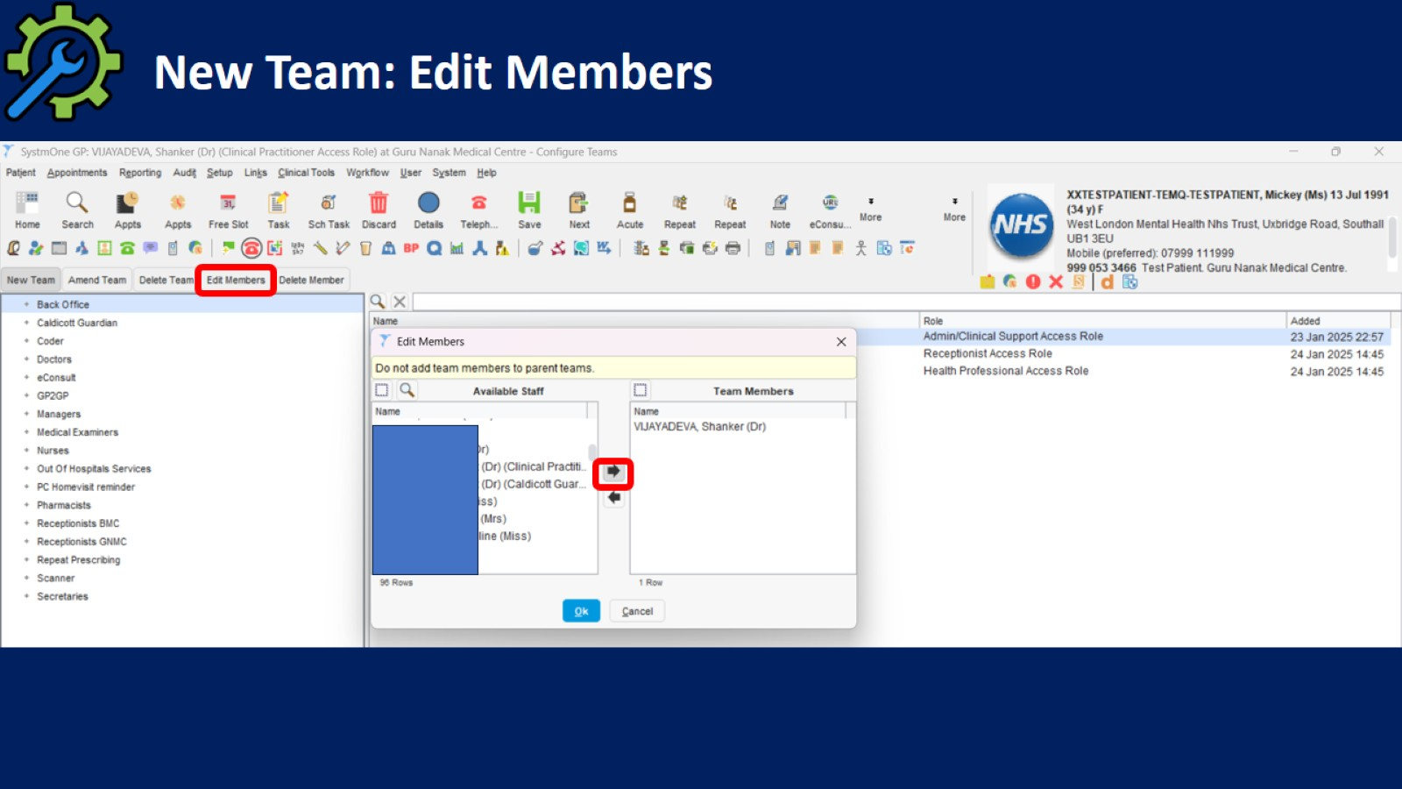
New Team: Edit Members

Slide 10
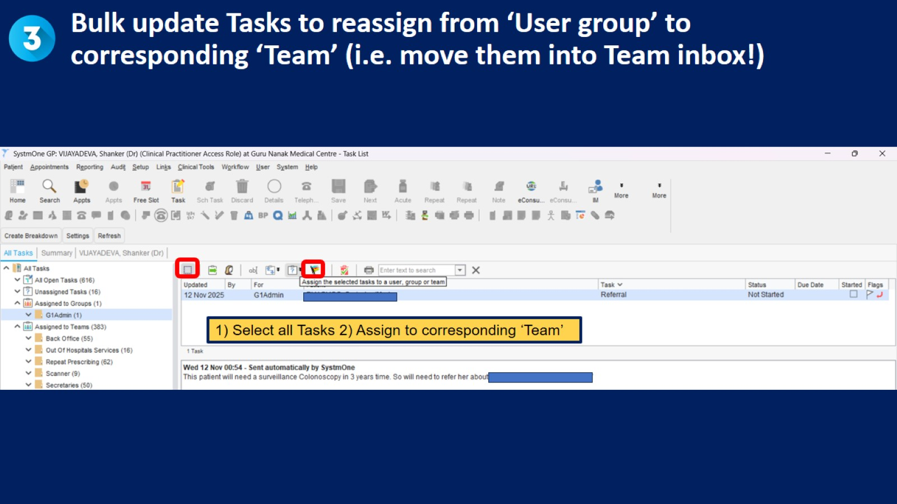
Bulk update Tasks to reassign from ‘User group’ to corresponding ‘Team’ (i.e. move them into Team inbox!)

Slide 11
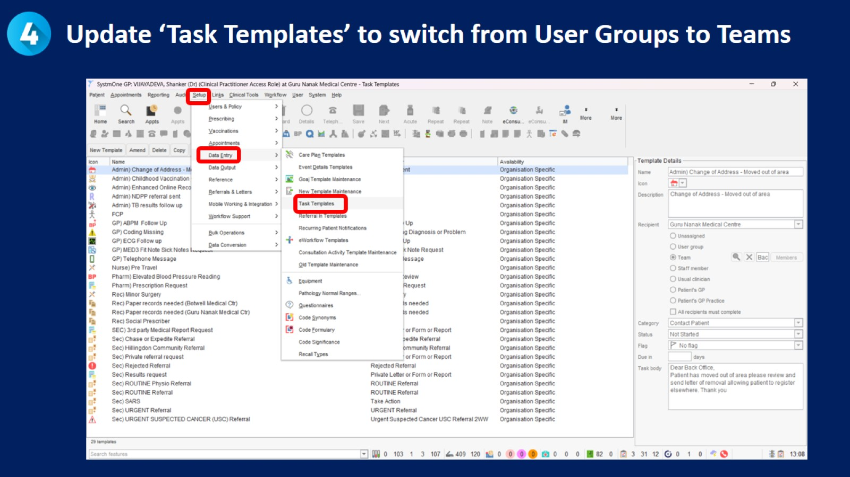
Update ‘Task Templates’ to switch from User Groups to Teams

Slide 12
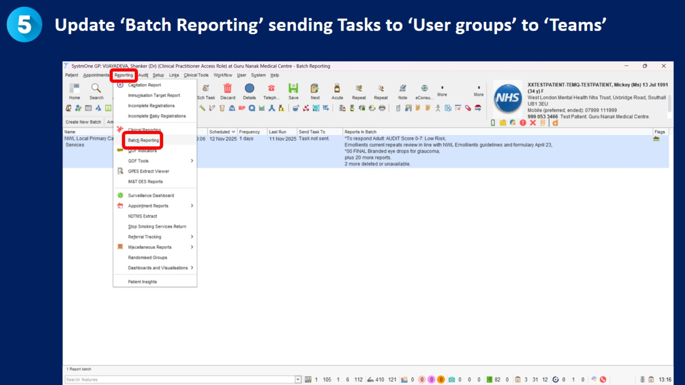
Update ‘Batch Reporting’ sending Tasks to ‘User groups’ to ‘Teams’

Slide 13


Slide 14
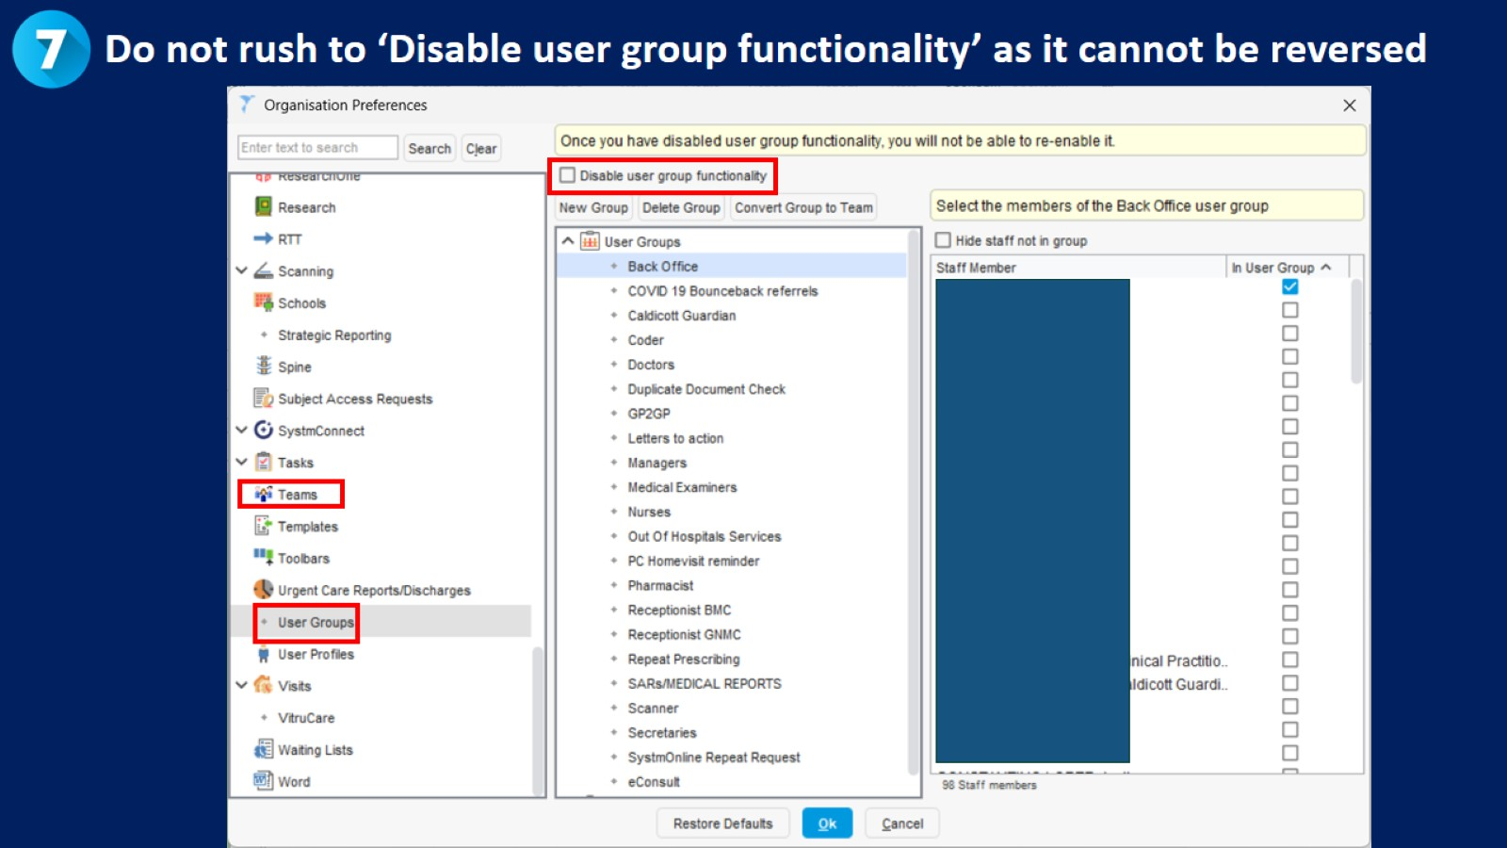

Slide 15
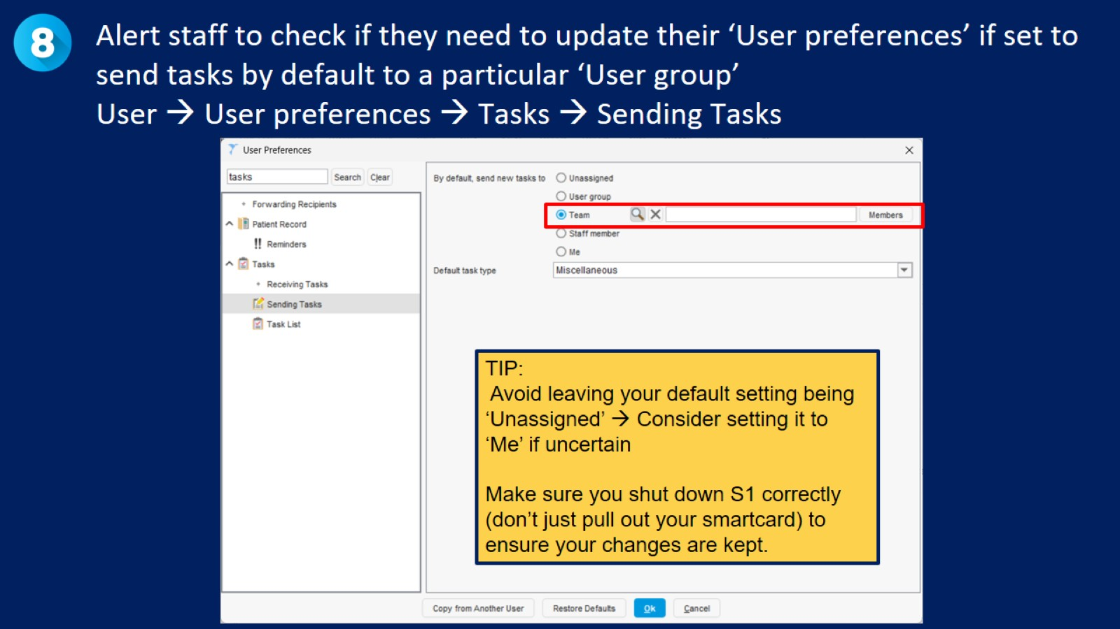
Alert staff to check if they need to update their ‘User preferences’ if set to send tasks by default to a particular ‘User group’
User → User preferences → Tasks → Sending Tasks

Slide 16
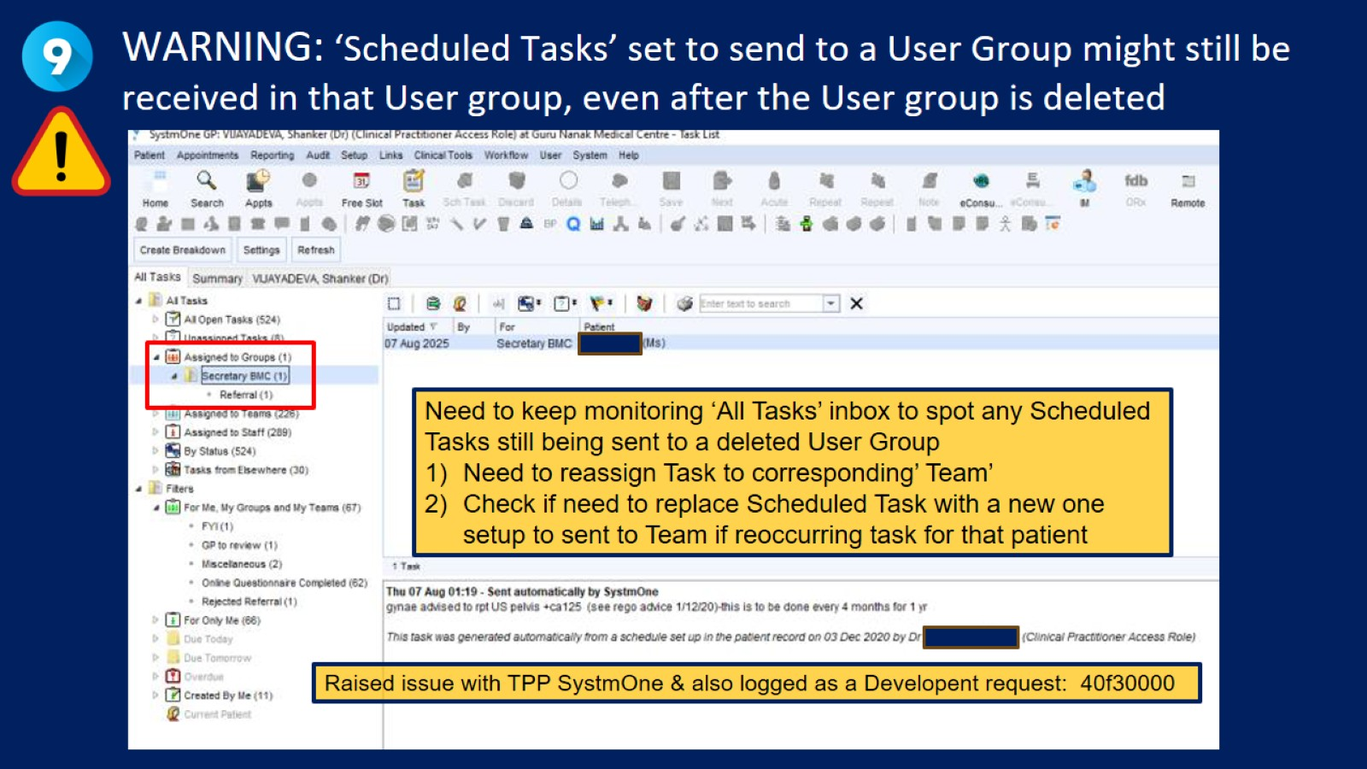
WARNING: ‘Scheduled Tasks’ set to send to a User Group might still be received in that User group, even after the User group is deleted

Slide 17
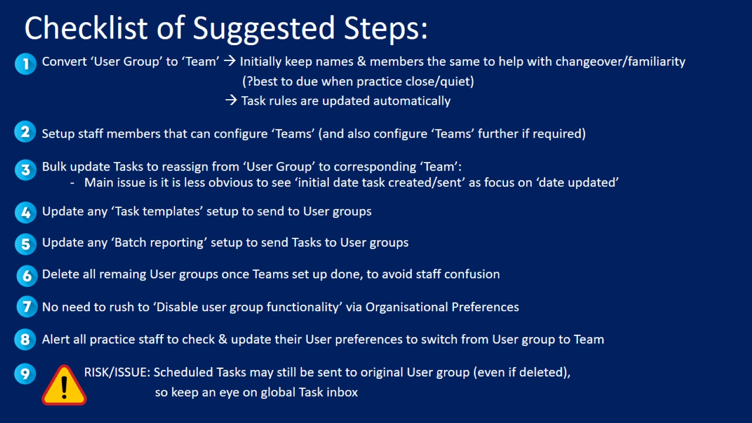
Checklist of Suggested Steps:

