Slide 1
Teams User Guide
GP / Primary Care
Northwest London ICB
September 2024

Slide 2
Topics covered:
What is Microsoft Teams
Navigation
Accessing Features
Office Applications Integration
Retention and Recovery
FAQs

Slide 3

What is Microsoft Teams
How is it accessed?
Web Browser: Sign in at https://teams.microsoft.com/v2/
Desktop App: Look for the purple icon with two figures
Or, Mobile App: Available for Android and iOS devices
Chat, 1:1 meetings and messaging
Video Conferencing
File sharing & collaboration
Team workspaces

Slide 4
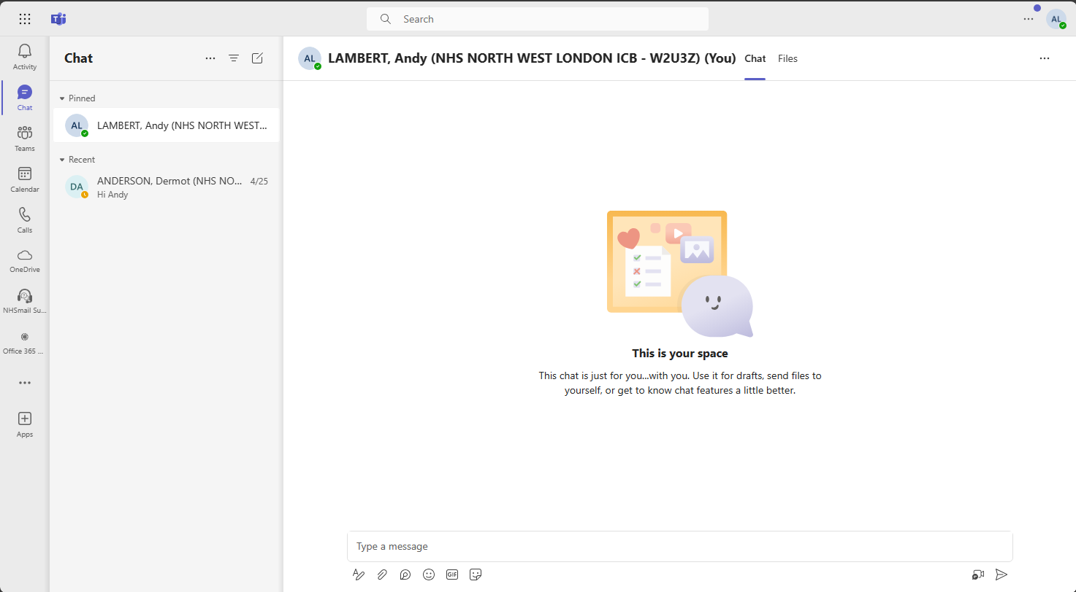

NAVIGATION
COMMAND BAR
SAMPLE, User
S
U
SAMPLE, User
NAVIGATION BAR
CHANNELS
DETAIL WINDOW

Slide 5
NAVIGATION BAR
Much of the navigation around Teams utilises the Navigation Bar, on left-hand side of the application.
Selecting the icon changes the detail window to that chosen feature.
Activity: Shows notifications, mentions, and recent activity
Chat: One-on-one and group conversations
Teams: The list of workspaces organised into channels
Calendar: Meeting schedule synchronised with Outlook
Calls: Make and receive audio and video calls
OneDrive: Access to your OneDrive files
NHSmail Support: The NHSmail support site provides detailed guidance and self-help articles for queries associated to NHSmail
Office 365 Updates: Broadcast messages

Slide 6
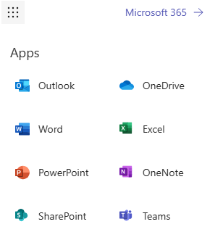

COMMAND BAR
Waffle
Will display and allow access to other applications available to users
Search
This will allow a search for items, such as files, chat and channels, that the user has access to
1.
2.

Slide 7
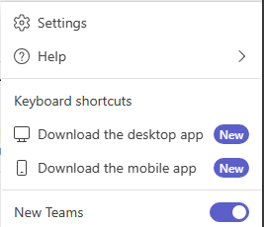
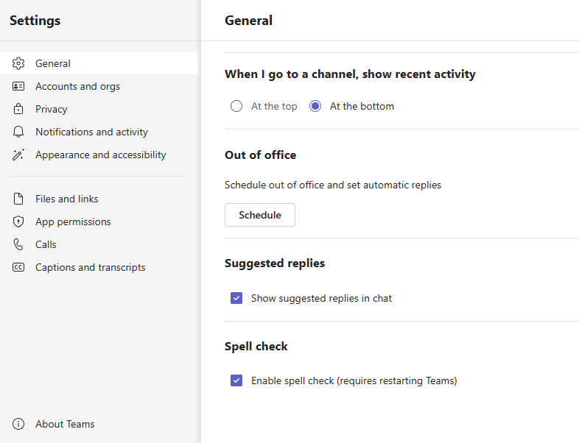
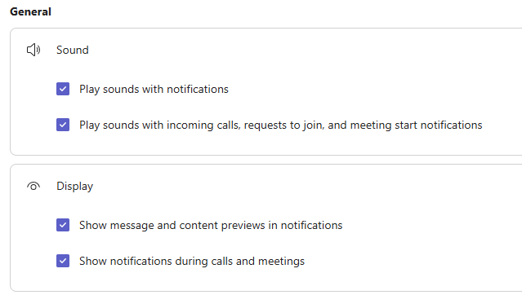
COMMAND BAR
Settings option from elipsis (…)
Will open a menu to allow users to manage a variety of settings. The most common that can be used are:
  General▶Out of office
  Notifications and Activity can change how user gets notified of any updates
1.
2.

Slide 8
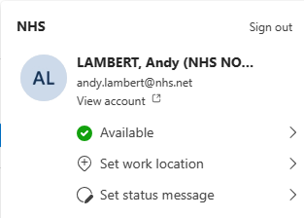
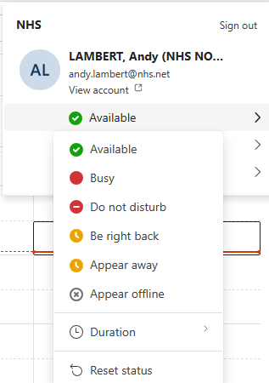
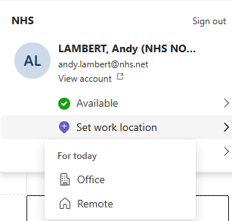
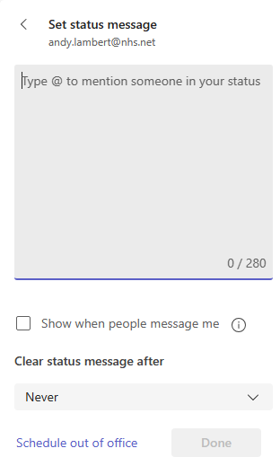
COMMAND BAR
Account
Clicking the account icon (top right) allows several actions to be carried out
  Set current status (to over-ride that set by Teams)
  Set work location
  Set status message
SAMPLE, User
User.sample@nhs.net
1.
2.
3.
SAMPLE, User
SAMPLE, User
User.sample@nhs.net
User.sample@nhs.net
User.sample@nhs.net

Slide 9
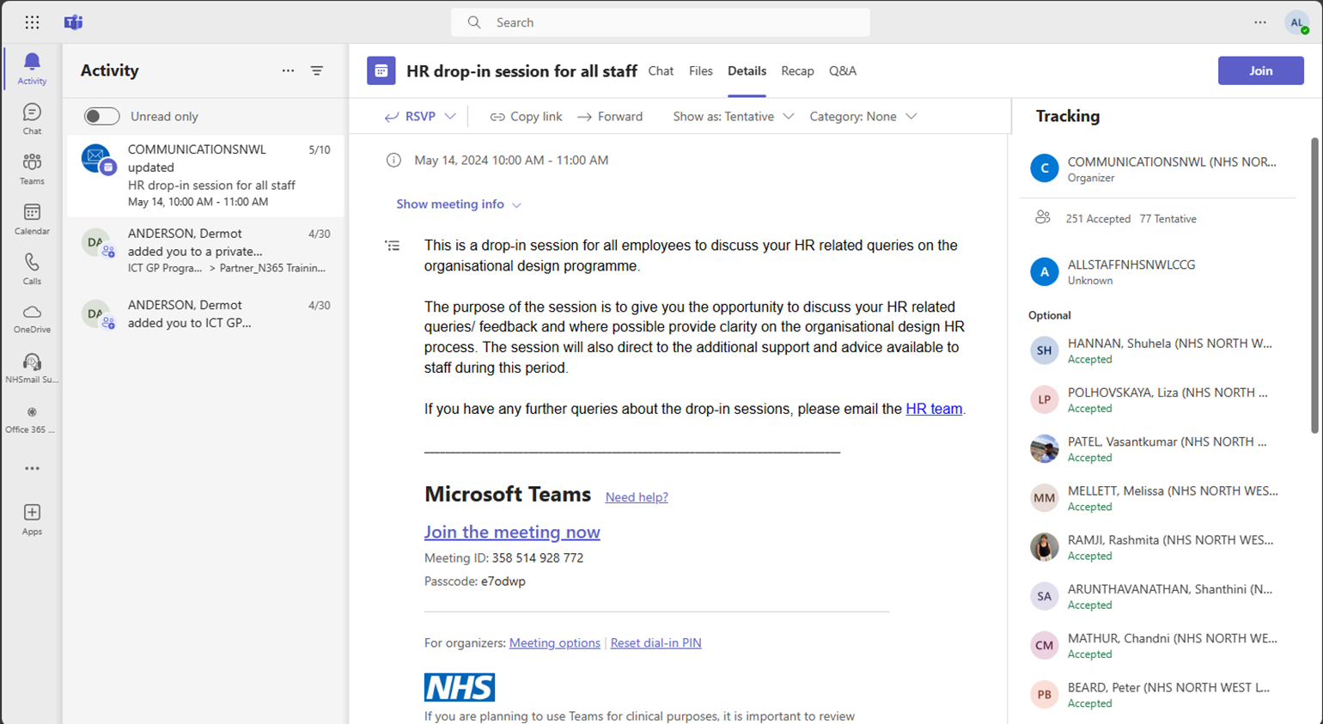
FEATURES
Activity
Displays all new (unread) and previous (read) notifications
ASDF, User
ASDF, User
HOW, Sample
PEOPLE, Leave
DOE, John
MANY, Meem
DOE, Jane
ANY, Sample
MANY, Chris
BALL, Paul

Slide 10
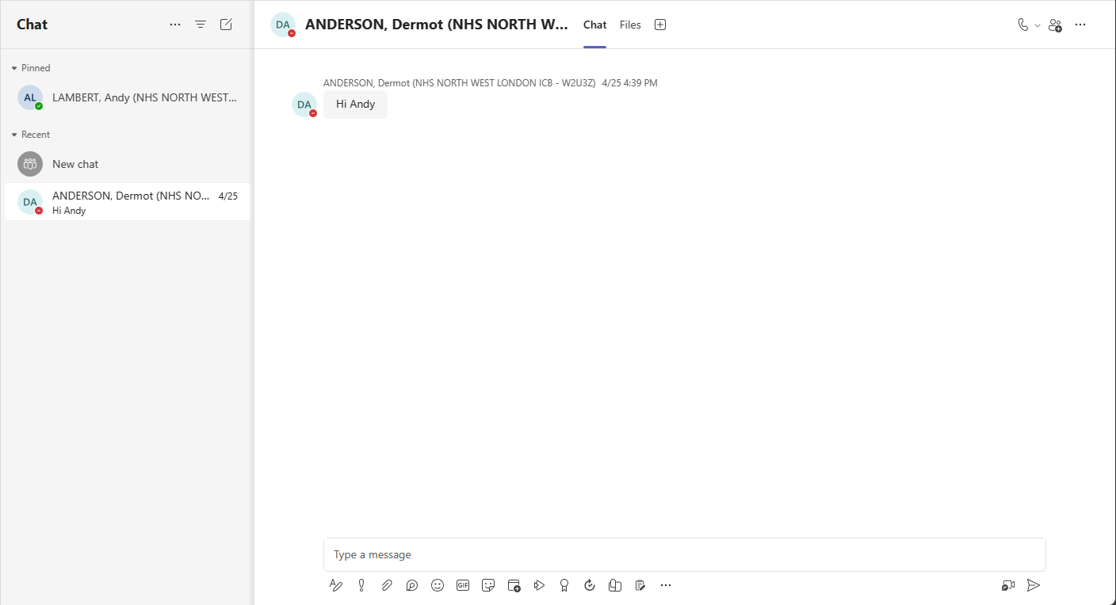
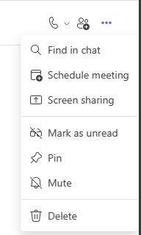
FEATURES
Chat
Within Chat there are several features
Reply to existing chat
Action for existing chat
  Schedule a meeting
  Share screen
  Mute (so stop any notifications relating to this chat)
Create new chat
New Chat
ASDF, User
SAMPLE, User
ASDF, User
ASDF, User

Slide 11
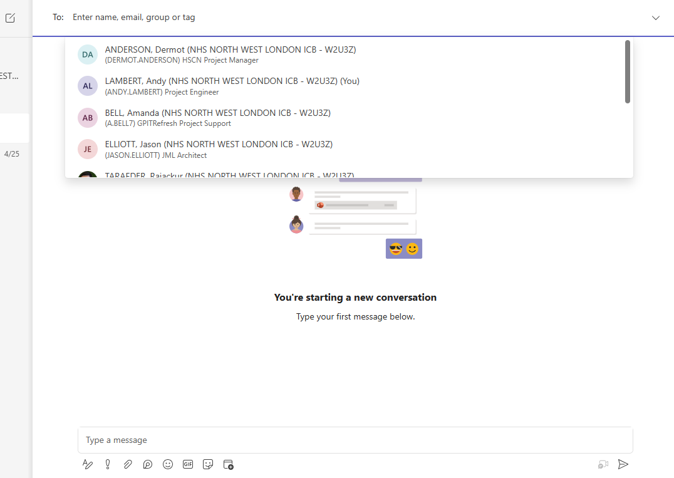
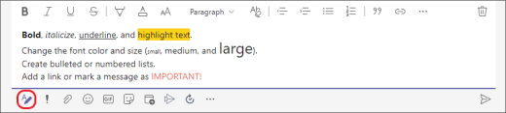
FEATURES
New Chat
Select one or more people to chat with
Create message
  use {shift + enter} for new line
Formatting message (function bar at bottom of screen)
Include files, GIFs, Emojis, etc
Set any delivery schedule
Send
ASDF, User
(User ASDF) Engineer
SU
SUPER, User
(User ASDF) Engineer
ASDF1, User
(User ASDF) Engineer
ASDF2, User
(User ASDF) Engineer
Formatting functions
Send

Slide 12
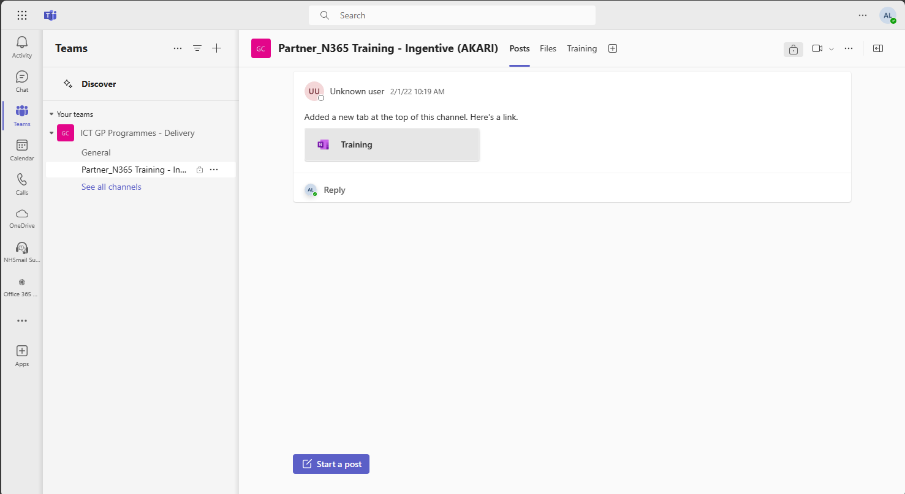
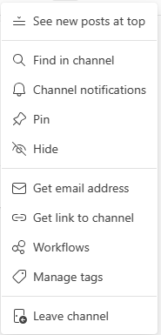

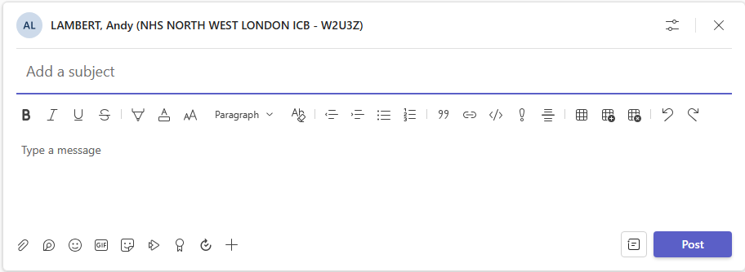
FEATURES
Teams
On entry the screen will show all Teams you have joined
Under each Team is a display of Channels
Each Channel will have a ‘Posts’ and ‘Files’ tab
Posts – Ability to ‘Reply’ to an existing Post, or create a new Post
The ellipsis ( ) enables functions to be performed within the Channel
Reply and Start a Post opens a dialogue box, like Chat with similar functionality
E****Radiotherapy
SAMPLE, User
SU

Slide 13
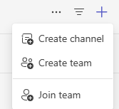
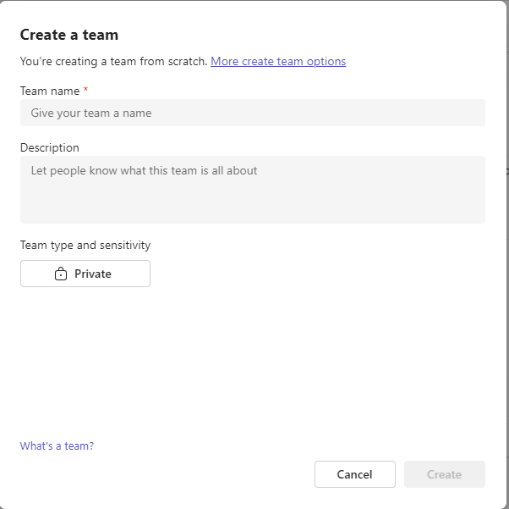
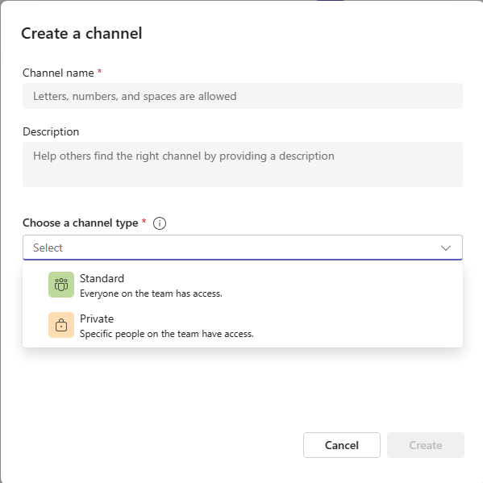
FEATURES
Teams – Create new
Clicking the + button allows for creation of either
  a new Channel (within existing Team)
  or a new Team
Complete the Name and Description boxes, and select whether these are
  Public – Visible to all
  Private – Only those invited will have ability to view
1.
E****Radiotherapy
NOTE: New Teams are requested through the Service Desk. These are created using the standard naming convention <E****><Practice Name>. As part of the creation process all new Teams are created with a standard ‘General’ channel, and in addition a ‘Management’ channel for Confidential documents.
1.a
1.b
2.

Slide 14
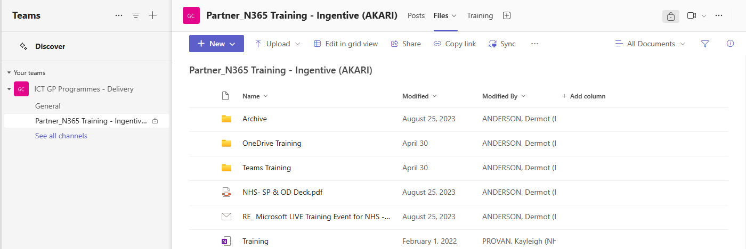
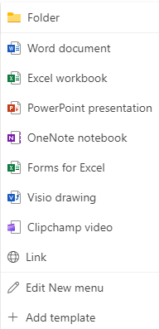
FEATURES
Teams – Files
Within the selected Channel there is the ability to store documents
These are then shared with all that are members of the Team/Channel
  The ‘New’ button provides a dropdown list
  That the user can select to create a variety of Office application documents and folders within the Channel
1.
2.
SUPER, User
SUPER, User
SUPER, User
SUPER, User
SUPER, User
SUPER, User

Slide 15
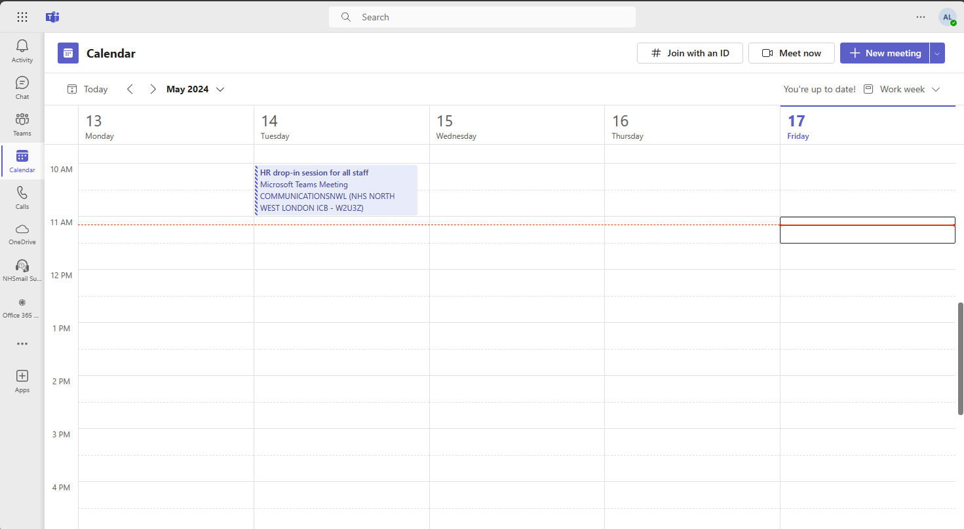
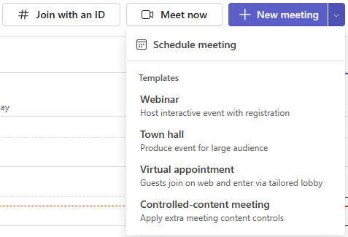
FEATURES
Calendar
This presents a view of the users Outlook calendar, with similar functionality
It provides ability to
  Join a Teams meeting
  Meet other users now
  Create a Teams meeting
  Or use a template to create a specific meeting type

Slide 16
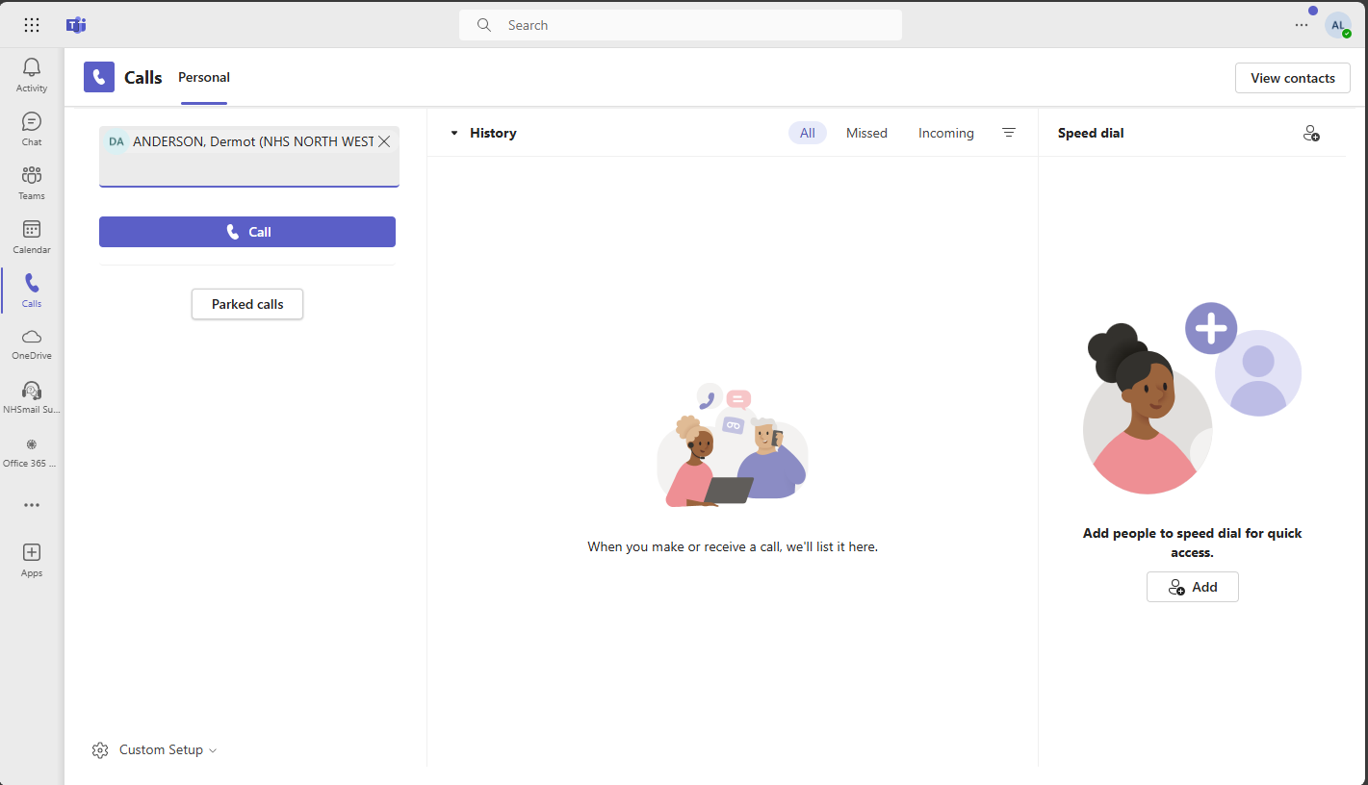
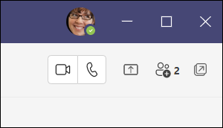
FEATURES
Calls
Enables call to be made to other users either as 1-to-1 or as a group (multiple users)
Once in a call there is the capability to move from audio call to video call, and vice-versa
ASDF, User
1.
2.

Slide 17
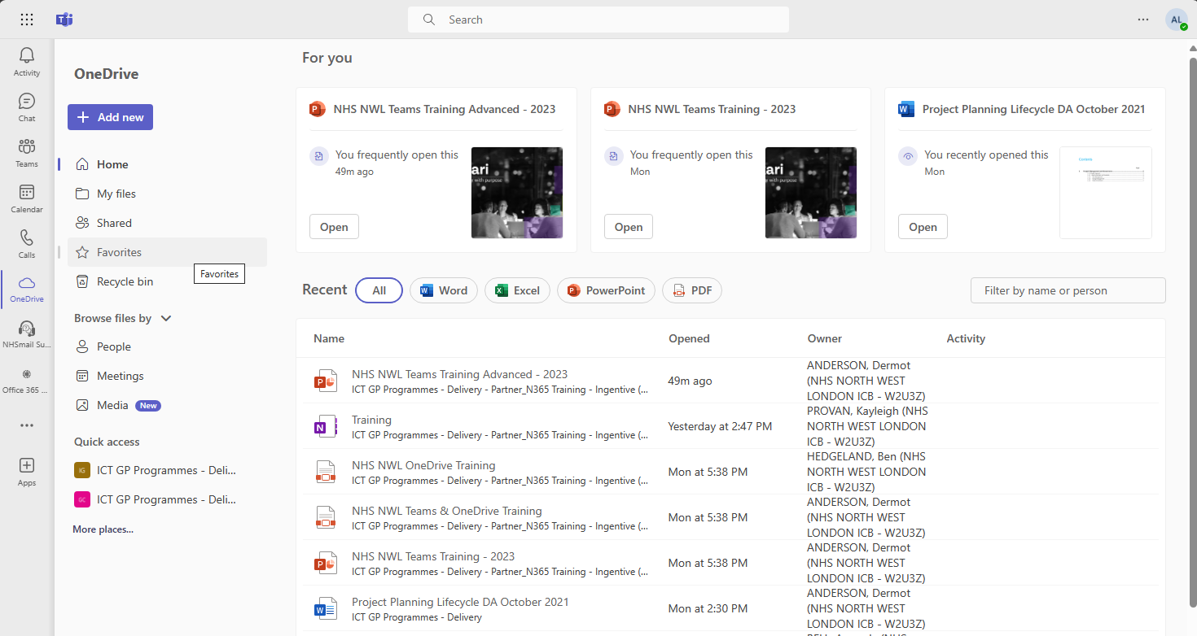
FEATURES
OneDrive
Home lists all the files recently viewed or edited.
My files lists all the files and folders from users personal OneDrive.
Shared shows all the files and folders shared with you and created by you.
Favorites shows files marked as your favorite files.
Recycle bin shows files that have deleted. And allows restores of these if necessary
SUPER, User
SUPER, User
SUPER, User
SUPER, User
SUPER, User
SUPER, User

Slide 18
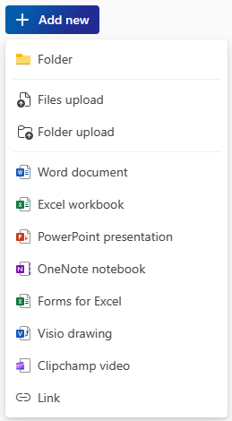
FEATURES
OneDrive – Add New
Ability to create a variety of Office application documents, or folders, into OneDrive
1.
SUPER, User
SUPER, User
SUPER, User
SUPER, User
SUPER, User
SUPER, User

Slide 19
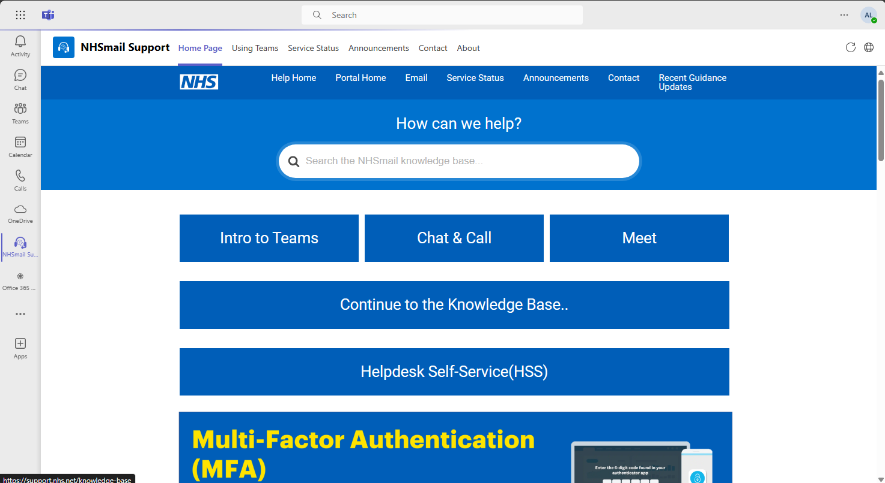
FEATURES
NHSMail Support
Contains some useful updates and content pertaining to Microsoft Teams, but also the wider Microsoft 365 environment

Slide 20
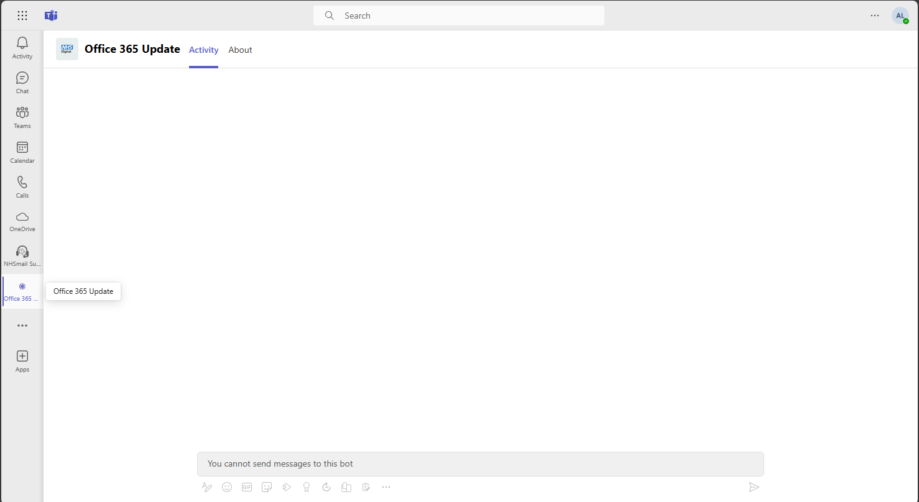
FEATURES
Office365 Update
Will present any broadcast updates available within the Microsoft 365 environment

Slide 21
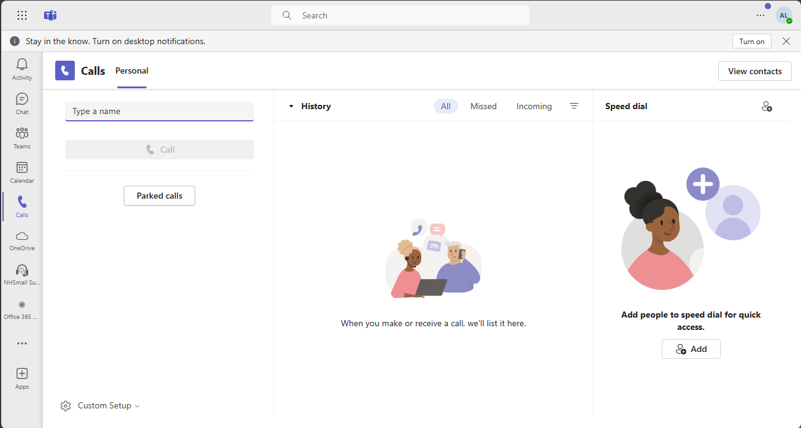
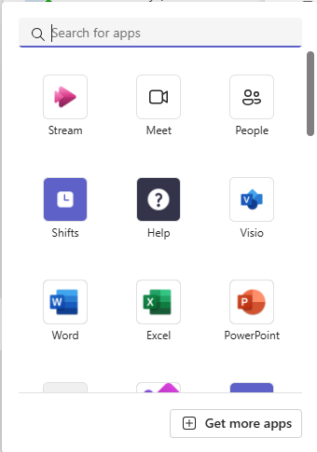
FEATURES
Apps (…)
Allows users to add additional apps to the Navigation Bar
Note: Additional apps added may not be supported by NWL IT

Slide 22
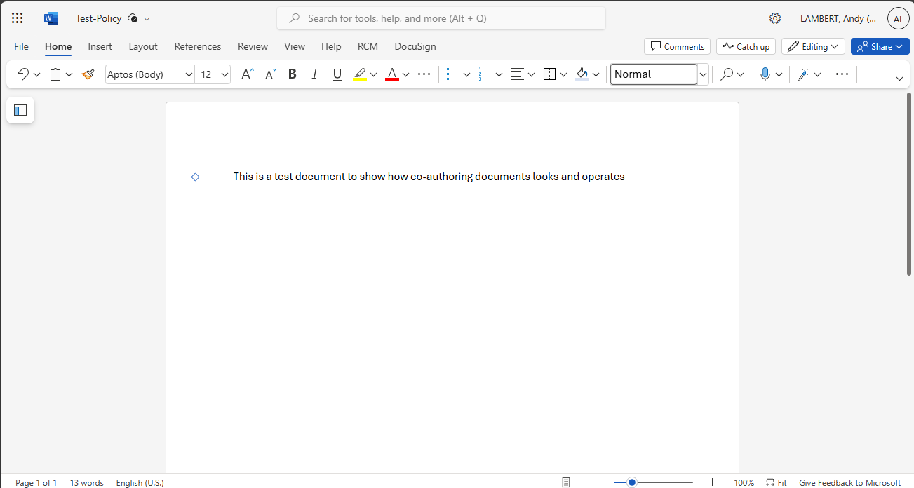
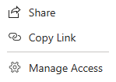
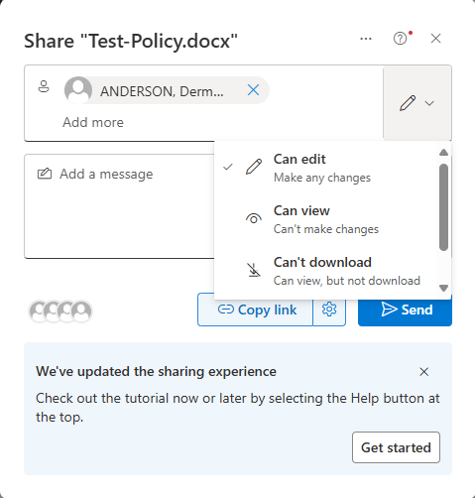
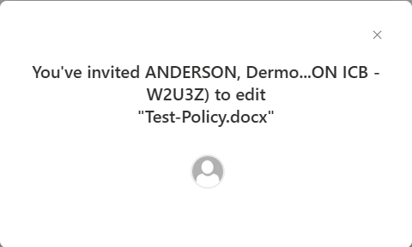
OFFICE APPLICATION INTEGRATION
1.
When working within an Office application, such as Word, users can enable others to co-author very easily.
Open the ‘Sharing’ button (top-right)
Select ‘Share’ from dialogue box
Within the sharing settings, select user(s) to share document with, and check what access is being provided
Then press ‘Send’; and a confirmation box will appear
SUPER, User
SU
2.
3.
ASDF, User
4.
ASDF, User

Slide 23
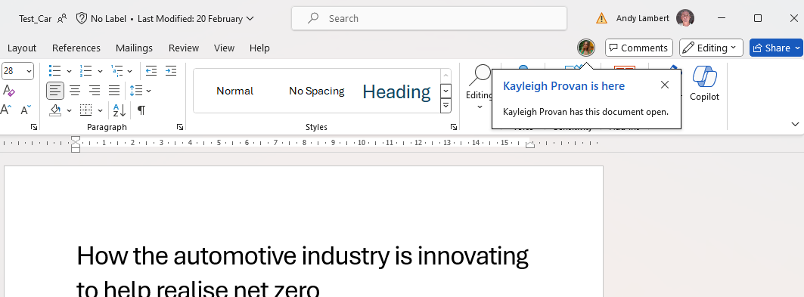

CO-AUTHORING
When a document (Word, Excel, PowerPoint, etc) has been shared the ability to co-author is available.
Users invited to co-author a document and that have it opened, will show in the top bar
Any changes being made within the document will be highlighted
User Super
SU
1.
KP
Key Person is here
Key Person has this document open.
2.

Slide 24
WHERE TO STORE DOCUMENTS?
Teams
OneDrive
Where to create and store content depends on who needs access to it.
OneDrive is ideal when working on a new document without the need to collaborate with others (Personal)
Teams can then be used to involve a small group to collaborate and finalise a document (Collaborate)

Slide 25
FREQUENTLY ASKED QUESTIONS (FAQs)
How Do You Blur the Video Background?
To do this, click the More Actions button during the call, and then Video Effects. Here, select the option to Blur Background. To turn it off, simply tap on the same button. This time, it will say: Don’t Blur Background.
Can I Set a Background Filter?
A background filter can be set by you in advance, and it will appear as your background on all your calls.
Before joining a meeting, turn the camera on and toggle the button underneath that says, “Background Filters”.
Then select Blur or an image from from the MS Teams library or upload an image to make your background (file must be .JPG, .PNG, or a .BMP format).
To turn off the background, simply click on the first option: None.
How to Screen Share MS Teams on a Desktop
This can be done while using Teams on a Windows, Mac, Linux, or Chromebook computer.
While in the meeting, go to the top of the Teams interface and select the up-arrow icon for Share Content.
From here, enter Presenter Mode and you can choose to share your entire screen, or just a specific window.
  The shared screen/window will have a red box outlining it.
To stop sharing, click the Stop Presenting button at the top of the Teams interface.

Slide 26
FREQUENTLY ASKED QUESTIONS (FAQs)
How to Share Files on MS Teams
To share files with team members, whether that be the entire group or a specific person, follow these steps:
  Look for the paperclip icon at the bottom of your chat field with the person or people you want to send it to.
  Identify the file to share and select it.
  Send it to the recipient/s.

