Slide 1
TPP SystmOne Training Academy – Manager Instructions

Slide 2
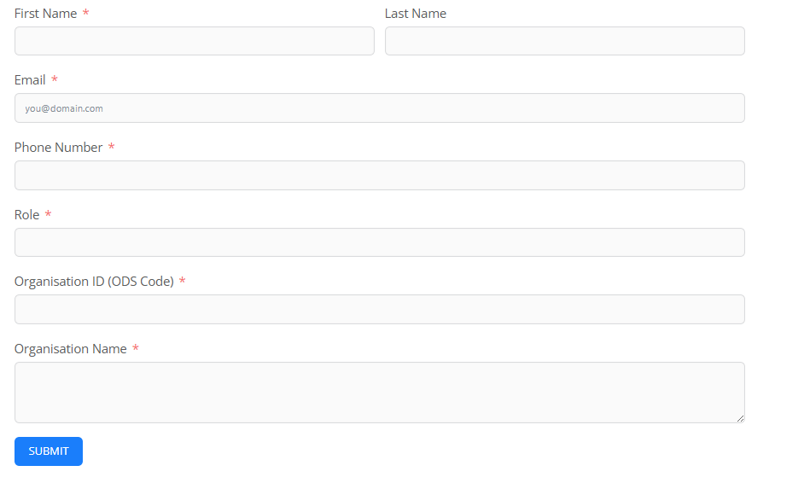
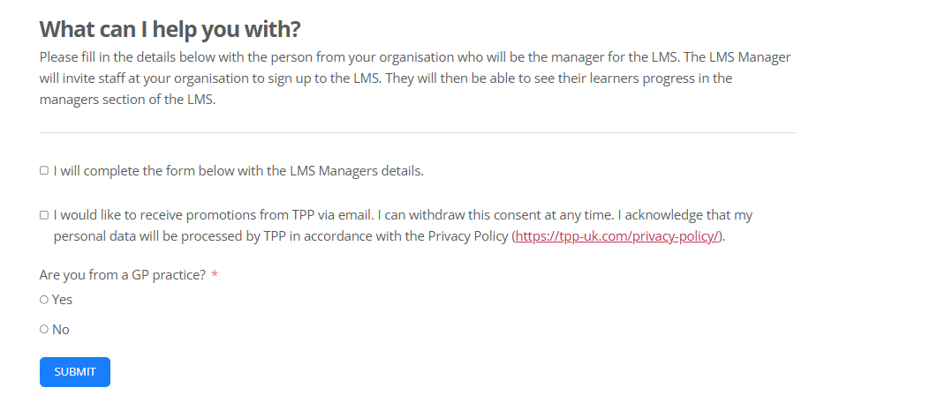
How to sign up
To sign up to the LMS:
Firstly, practices need to decide a ‘Manager’ who applies by filling out this form
(https://tpp-uk.com/lms-contact-form/) to register.
Notes:
Please fill in the details below with the person from your organisation who will be the manager for the LMS. The LMS Manager will invite staff at your organisation to sign up to the LMS. They will then be able to see their learners progress in the managers section of the LMS. Please fill in the details below with the person from your organisation who will be the manager for the LMS. The LMS Manager will invite staff at your organisation to sign up to the LMS. They will then be able to see their learners progress in the managers section of the LMS.
Complete the form with your name, email, phone number, role, Organisation ID (ODS Code), Organisation Name.

Slide 3
Steps for the Manager
The manager will receive an email containing a link to verify their account.

Slide 4
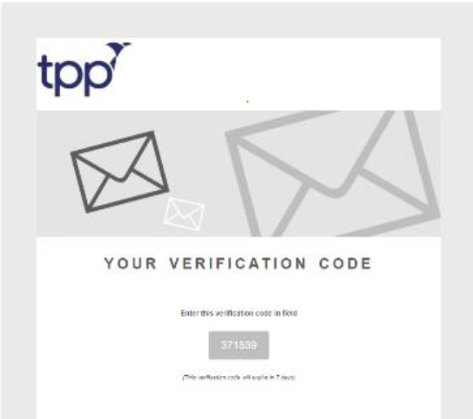
Verification Code
Once the email has been verified, you will receive a second email which will contain a verification code. Enter the verification code into the LMS portal.

Slide 5
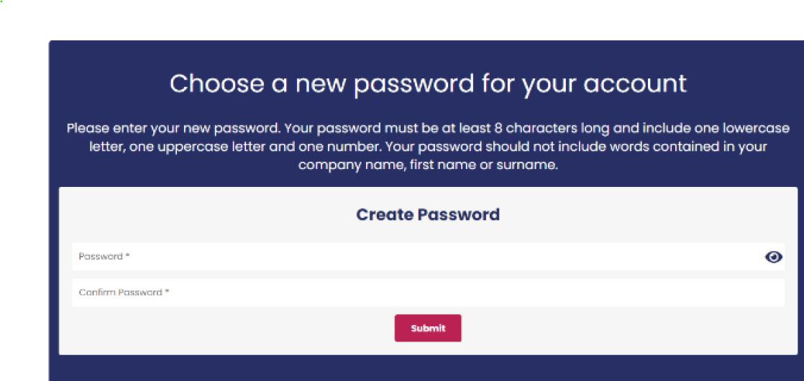
Password
Next, you will need to set your own personal password for the LMS.

Slide 6
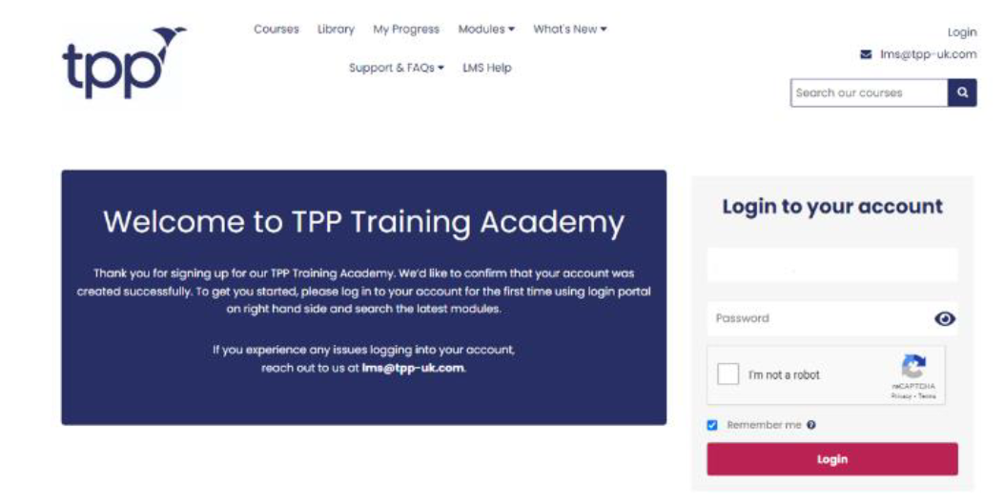
Login to the LMS
You will then be asked to login with your email and password to access the relevant courses

Slide 7
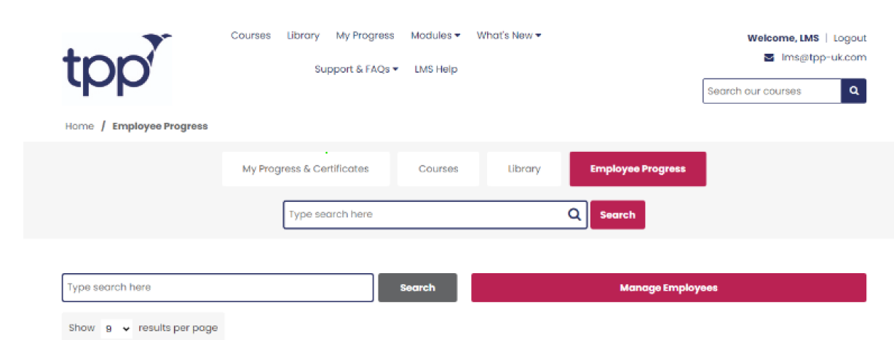
Add your Staff
You will then need to select ‘Employees Progress’ and the ‘Manage Employees’

Slide 8
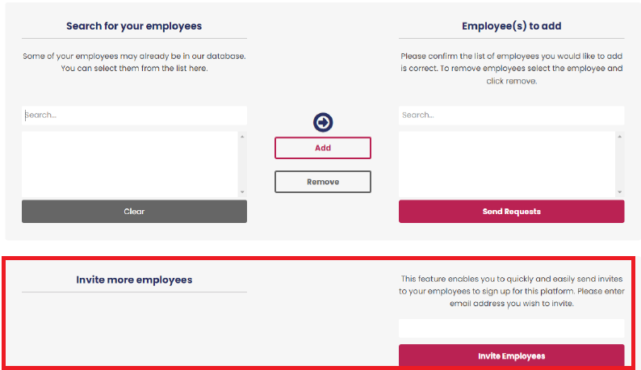
Invite your Staff Members for Access
The manager can send invites to their staff by typing in the employees’ email in the below box and selecting ‘Invite Employees’. The invites will then be sent to your employee’s email accounts.

