Slide 1
Pharmacy First
Digital transformation of
Primary Care general practice and community pharmacy
3 April 2025

Slide 2

Colour key for document -
General information
Information for general practice
Information for community pharmacy
Contents
Introduction | 3
Streamlining GP referrals to community pharmacy – Referral Standard | 6
Information for general practice | 11
Information for community pharmacy | 14
Accessing clinical information – GP Connect: Access Record Structured | 17
Protecting patient data | 22
Information for general practice | 25
Information for community pharmacy | 31
Updating the patient’s GP record – GP Connect: Update Record | 36
Information for general practice | 42
Information for community pharmacy | 48
Managing live issues | 54
Links | 56

Slide 3
Digital transformation
  NHS England has significantly improved the digital infrastructure between general practice and community pharmacy to support the implementation of Pharmacy First, and the expansion of the Blood Pressure Check Service and Pharmacy Contraception Service.
Enable easy, streamlined digital referrals from general practice to community pharmacy
(Referral Standard)
Provide community pharmacy real-time, read-only access to
patient GP records
(GP Connect Access Record: Structured)
Streamline claim processes and monitoring of services
(NHS BSA Payment & Data APIs)
Signposting to support patients to choose community pharmacy
(DoS, Profile Manager, nhs.uk and 111 online and 111 telephony pathways)
Send structured information to update patient GP records after community pharmacy consultations
(GP Connect Update Record: Structured)
Assured clinical systems used in community pharmacy to meet national standards
(Digital Service for Integrated Care for Community Pharmacy)

Slide 4




Scale of transformation to improve patient care
3
Live Clinical Services
Pharmacy First Service*
10,000+
pharmacy (opt-in)
c6,250
GP practices
5 suppliers
6 clinical systems
16,250+ sites
Blood Pressure (BP) Check Service
Pharmacy Contraception Service
Safe
Secure
Resilient
Compliant
Pharmacy First Service
BP Check Service
Contraception Service
Impact
Reduced frontline burden and improved access and services for patients
Navigation
Navigation
Navigation
DoS & Bookings & Referrals
Consultation Record
Consultation Record
Consultation Record
Access Record: Structured
Scale, once fully rolled per month:
Update Record: Structured
Update Record: Structured
Update Record: Structured
170k referrals into pharmacy workflows
660k views of real-time clinical information
660k structured updates into GP workflows, and into patient’s hands in the NHS App
Payment & Data API
Payment & Data API
Payment & Data API
* Covers 3 flows of patients: 1) GP, NHS111 and Urgent Treatment Centre referrals for minor illness 2) NHS111 referrals for Emergency Supply of Medicines 3) GP and NHS111 referrals or walk-ins for seven conditions

Slide 5
Benefits: reduce burden and improve patient care
Digital improvements is reducing burden and improving patients experience and safety, freeing up general practice appointments for patients who need them most, giving people quicker and more convenient access to high quality healthcare.
Baseline evidence from general practices and community pharmacies visited over the last three months has shown significant variation in the amount of time it takes to process referrals, access clinical information and update the patient GP record. The minutes saving statements below are the estimated minimum benefit of implementing in-workflow referrals, enabling sharing of clinical information and streamlined updating of the patient GP record:
General practice and community pharmacies
Less manual burden to manage referrals
Community pharmacies
Less logins to access patient information
General practice
Less admin burden to update the patient GP record
3-minute saving per in-workflow referral
1-minute saving per view of patient GP record
2-minute saving per community pharmacy consultation

Slide 6
Streamlining referrals from general practice to community pharmacy
Referral Standard
Notes:
Standard title slide

Slide 7





Referral process for general practice
EMIS Web
Process unchanged for EMIS Web users
Referrals sent directly into community pharmacy workflows.
EMIS Web users who do not have the Local Services add-on will continue to use NHSmail to make referrals.
Process unchanged for Optum PharmRefer users
Referrals sent directly into community pharmacy workflows.
TPP practices who use Optum PharmRefer for referrals should work with the ICBs to agree licencing arrangements and the plan to start using SystmOne in-workflow referrals.
PharmRefer is retiring the ‘cancel referral’ feature.
NEW – TPP in-workflow referrals (Q1, 2025/26)
TPP are rolling out the ability to send in-workflow referrals from SystmOne
General practice will need to ensure they provide pharmacy contact details when they refer a patient.
TPP will issue user guidance as a ‘Notice’ a week before rolling out.
ICBs/PCNs/practices can add clinical content to develop a clinical assessment tool to support triaging.
SystmOne
If digital referrals are unavailable, or there is a gap between licences for products, general practice teams should refer patients via NHSmail rather than NHS 111.

Slide 8



Referral Standard
The Referral Standard enables GP IT systems to send standardised referrals directly into community pharmacy clinical IT systems. General practice cannot use this system yet to book community pharmacy appointments.
A patient journey - from the patient presenting with symptoms, to appropriate treatment - often involves two or more NHS services. Clinical and administrative information is sent and received at all stages of this journey.
This new Referrals Standard streamlines the way Pharmacy First referrals are sent from general practice to community pharmacy. Community pharmacies now receive the information they need, in a standardised format they can use, integrated into their clinical system.
      More information is available at:
      Referral Standard - NHS England
      BaRS Core - core set of functionality and BaRS applications

Slide 9


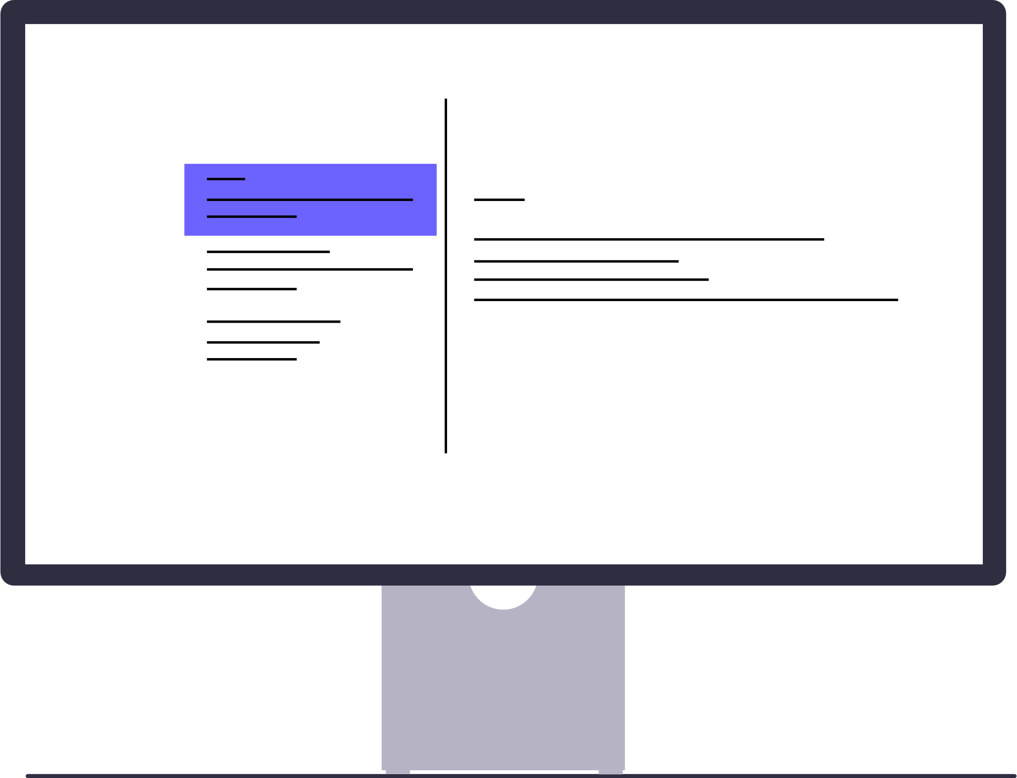



Steps to refer patients from general practice to
community pharmacy using assured in-workflow referrals systems
General practice
Community pharmacy
  Step 1:
  Patient presents or calls their general practice – triaged as appropriate for referral against service specification
  Step 2:
  General practice creates a referral by entering the presenting complaint, including relevant details for the recipient, and select an appropriate pharmacy using the Directory of Services (DoS)
  Step 3:
  The referral is sent. General practice provides the patient with the pharmacy contact details so they can arrange when they visit the pharmacy
  Step 4:
  Referral received directly into the community pharmacy clinical system
  Step 5:
  Patient seen by community pharmacy (in person or online)

Slide 10






Information sent in referral to community pharmacy
The in-workflow referrals contain the following information:
Personal demographics – name, date of birth, gender, ethnicity, NHS number, address, preferred contact method, telephone number, email address
General practice information including ODS code
Legal information including consent for information sharing
Clinical summary – clinical narrative
Referral details – date of referral, service of the referrer, referral type for example Pharmacy First, contact details of referrer, person referral reference journey ID, ODS code of the community pharmacy
Presenting complaints or issues

Slide 11
Information for general practice
Referral Standard

Slide 12




Directory of Service: Distance Selling Pharmacies
When a general practice makes a Pharmacy First referral the system will use the Directory of Service to return a list of nearby community pharmacies, which may include distance selling pharmacies (DSPs).
General practice cannot refer patients with suspected Acute Otitis Media (earache) to distance selling pharmacies for the Pharmacy First Service.
Distance selling pharmacies only provide remote (telephone or online) consultations.
A distance selling pharmacy is not always identifiable by their name or address, so the referrer needs to work with the patient to choose the pharmacy before the referral is sent.

Slide 13



Benefits for general practice
Accurate information: General practice teams have access to an up-to-date list of nearby community pharmacies to support patients having choice. The referrer can offer the patient a face-to-face consultation in a pharmacy or a remote consultation via telephone or online (excluding suspected acute otitis media).
Streamlined referrals: General practice teams can send referrals to community pharmacy from within the workflow, avoiding the need to log into different systems, saving time.
Safe patient care: Patient referral information is sent in a structured, standardised format to community pharmacy workflows, improving patient safety.

Slide 14
Information for community pharmacy
Referral Standard

Slide 15


Receiving referrals from general practice
Community pharmacies receives Pharmacy First referrals directly into the same clinical IT system as NHS 111 referrals.
Referral information is sent in a structured, standardised format to support the patient consultation.
Actions for registered community pharmacy professionals
  Business continuity: Continue to monitor NHSmail for all other referrals. Email remains a business continuity solution for referrals from both general practice and NHS 111 if the in-workflow referral system fails.
  Directory of Services: The referral system uses the Directory of Services to display a list of community pharmacies, including distance selling pharmacies that provide the NHS Pharmacy First Service. It is important community pharmacies ensure the NHS Profile Manager entry is up-to-date.
      Directory of Services (DoS) - NHS England Digital

Slide 16



Benefits for community pharmacy
Accurate information: General practice teams will have access to accurate, up-to-date information via the Directory of Services, so community pharmacy teams can ensure patients who attend are being referred for services they can offer.
Streamlined in-workflow referrals: Community pharmacy teams will receive referrals directly into clinical
IT systems, reducing the need to work across two or more applications and saving time.
Patient safety: Patient referral information received is in a structured, standardised format, reducing the likelihood of errors and improving patient safety.

Slide 17
Accessing clinical information
GP Connect Access Record: Structured
Notes:
Standard title slide

Slide 18


Ways for registered community pharmacy professionals* to access clinical patient information
NEW
NCRS or SCR
PMR
ShCR
AR:S
Smartcard / Care Identity Service 2
Role Based Access Controls (RBAC)**
Patient Medication Record (PMR) if the patient is known to the community pharmacy
Shared Care Record (ShCR) if the patient lives in an area with ShCR and the pharmacy has access to the ShCR system
National Care Records Service (NCRS) or Summary Care Record (SCR) if the patient is not known to the community pharmacy, or if the patient is known but data is not available via PMR
Access Record: Structured real-time access to the patient’s GP record during the community pharmacy consultation. The following clinical information is available to view in the clinical system:
Medications
Investigations
Observation items – weight, height, body mass index, pulse rate, smoking status, alcohol intake and blood pressure readings
* Pharmacists and Pharmacy Technicians (General Pharmaceutical Council - register of clinical professionals)
** IT systems will apply Role Based Access Controls (RBAC) to provide access to registered community pharmacy professionals only.

Slide 19
GP Connect Access Record: Structured
GP Connect Access Record: Structured allows registered community pharmacy professionals to securely view areas of the patient’s GP record within their own assured IT system. Information is provided in a structured, standardised format that is user-friendly and easy to interpret.
Community pharmacy clinical service specifications (e.g. NHS Pharmacy First service specification) outline that with the patient’s consent, a pharmacist must consult the patients GP record, using GP Connect Access Record, National Care Record or an alternative clinical record.
Access Record: Structured is used for NHS direct care and gives registered community pharmacy professionals access to the real-time information they need for safe, informed clinical decision-making.
Areas of Access Record: Structured are already deployed in assured general practice systems, ready for approved clinicians to request. Assured community pharmacy suppliers have started to rollout, providing access to three clinical areas of the patient’s GP record:
Medications
Investigations
Observation items - weight, height, body mass index, pulse rate, smoking status, alcohol intake and blood pressure readings
      More information is available at: GP Connect: Access Record

Slide 20

GP Connect Access Record: Structured and NCRS
Features and information available to community pharmacy professionals | Access Record: Structured | NCRS (SCR)
Real time access to structured data | ✔️
Access from within pharmacy clinical system (as opposed to access via separate system/log in/browser) | ✔️
Available now
Medications (current/repeat/past) | ✔️ | ✔️
Observation items (weight, height, body mass index, pulse rate, smoking status, alcohol intake and blood pressure readings) | ✔️ | ✔️
Investigations (including blood tests, urinalysis) | ✔️
Potential development for community pharmacy access in the future
Allergies and adverse reactions | ✔️ | ✔️
Consultation encounters | ✔️ | ✔️
Problems/medical history | ✔️ | ✔️
Immunisations | ✔️ | ✔️
Key: ✔️ available ✔️ availability varies not available
See Summary Care Record and National Care Records Service for more information

Slide 21



Benefits to community pharmacy
Time saving: Less time switching between community pharmacy applications, providing role-based access without the need for a Smartcard
User friendly system: Provided in a structured format which can be filtered. Information not limited to the past 12 months
Improved clinical decision making: Reducing clinical risk and improving patient outcomes.
Joined up care: Verifying patient medical history and reducing burden on patient to remember or relay information
Patient safety: Ensuring community pharmacy have the most accurate, up-to-date information for patient care
‘Accessing the patient’s GP record was very straightforward. Each section was simple to navigate. The whole record was user friendly’
Feedback from Tower Pharmacy, London (pilot site)

Slide 22
Protecting patient data
Information governance for general practice and community pharmacy
Notes:
Standard title slide

Slide 23

Protecting patient data - Access Record: Structured
General practice
Community pharmacy
General practice's remains the data controller for their patients’ GP held records
Role-based access – registered community pharmacy professionals
Community pharmacies have signed up to the National Data Sharing Arrangement (NDSA) to use GP Connect*
NHSE monitoring and alerting if non-assured sections of the GP record are being requested, indicating a breach of connection agreement
Patient consent
is managed by the general practice
May only be used for NHS direct care
Information is read-only and cannot be extracted or stored in the community pharmacy system
Community pharmacies verify patient’s consent before viewing their GP record
*Pharmacy contractors who registered for the Pharmacy First, Blood Pressure Check, or Pharmacy Contraception Service will have signed up to the terms of the NDSA as part of registration with Manage My Service, NHS BSA.

Slide 24

The National Data Sharing Arrangement (NDSA)
Access Record: Structured
The GP Connect National Data Sharing Arrangement (NDSA) sets out the data sharing requirements and obligations for the use of GP Connect. This ratifies the safe sharing of clinical information through GP Connect to support direct patient care.
Use of GP Connect products requires the pharmacy contractor to first agree to the terms of the NDSA. Check which organisations use GP Connect on the NDSA Portal.
Pharmacy contractors who registered for the Pharmacy First, Blood Pressure Check, or Pharmacy Contraception Service will have signed up to the terms of the NDSA as part of registration. Users can also sign up directly on the NDSA Portal.
To sign up to GP Connect you must hold a current (valid) Data Security and Protection Toolkit (DSPT) for the pharmacy ODS code to be applied to the NDSA.
NHSE Information Governance, responsible for GP Connect, confirms the NDSA is sufficient to cover the rollout of Access Record: Structured and its enablement by default.
    More information is available at:
    National Data Sharing Arrangement for GP Connect - NHS England Digital

Slide 25
Information for general practice
GP Connect Access Record: Structured

Slide 26
What is GP Connect Access Record?
GP Connect Access Record has been used since 2018 to enable a variety of health and care professionals to access patients’ GP records in a range of settings*. In 2024, Access Record: HTML processed more than 257 million requests, and Access Record: Structured handled more than 6.2 million requests.
From March 2025, community pharmacy will start to use Access Record: Structured to support direct patient care.
Product | Description
Access Record: HTML | Enables a read-only view of a patient’s record for another care setting.
Access Document | Allows access to documents which are attached to the patient’s GP record, such as a consultation summary from another care setting.
Access Record: Structured | Provides access to a patient’s GP record in a machine-readable, structured, and coded format. Already adopted by NHS Trusts and primary care networks for access to medications and allergies records.
*Examples of where GP Connect: Access Record is being used is available on the GP Connect: Access Record website.

Slide 27
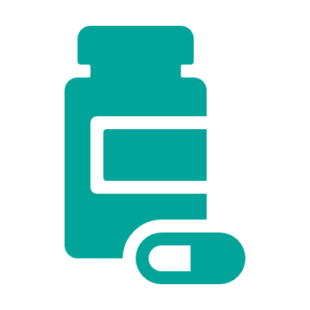


Accessible patient data
Access Record: Structured has started to roll out to community pharmacy for three areas of the patient’s GP record:
    Medications
    Observation items –weight, height, body mass index, pulse rate, smoking status, alcohol intake and blood pressure readings
    Investigations
Information will only flow to community pharmacy if Access Record: Structured is enabled within the GP IT system of an individual general practice and the patient has not withdrawn their consent.
Changes to the GP Contract in 2025/26
The Department of Health and Social Care (DHSC) and NHS England consulted with the profession on changes to the GP contract for 25/26. The agreed changes are set out in the contract announcement letter which includes a requirement (para 8) on general practices to ensure the functionality in GP Connect (Access Record: HTML, Access Record: Structured and Update Record: Structured) is enabled by 1 October 2025.

Slide 28



Data flow example – general practice view
General practice (GP) system
Community pharmacy (CP) clinical system
Request for patient data
CP
system
If Access Record: Structured is ON at the GP
GP system
ON
Patient data available
Patient data accessed
General practice is data controller
CP professional needs to access record
Patient
seen by CP
Error message sent if patient has opted out of GP Connect
Patient data not accessed if patient has opted out
If Access Record: Structured is OFF at the GP
Request for patient data
GP system
OFF
CP
system
Data not available – error message sent (or if patient has opted out of GP Connect)
Patient data not available
General
practice is data controller
CP professional needs to access record
Patient
seen by CP
May need to contact general practice for more information
NCRS/
ShCR
Use alternative sources

Slide 29



What do general practice teams need to do?
Enabling Access Record: Structured
EMIS Web
SystmOne
No action for practices who already have GP Connect Access Record: Structured (medications and allergies) enabled
For those who don’t:
General practices using TPP will need to enable remaining areas of Access Record: Structured
To do this:
Go to Organisation Configuration
Go to Organisation Preferences
Select Edit Organisation
Select Interoperability
Select GP Connect Configuration
Select Third Party Patient Record Settings
Under GP Connect API Configuration tick the box next to Structured Record to turn on
Select Enable Access Record Structured: Medications and Allergies if not already turned on
Select Enable Access Record Structured: Immunisations, Consultations, Problems, Investigations, Outbound Referrals, Diary Entries (Recalls), Uncategorised Data to turn on
Patients should contact their GP practice if they want to opt out of their patient GP record being shared via GP Connect.

Slide 30
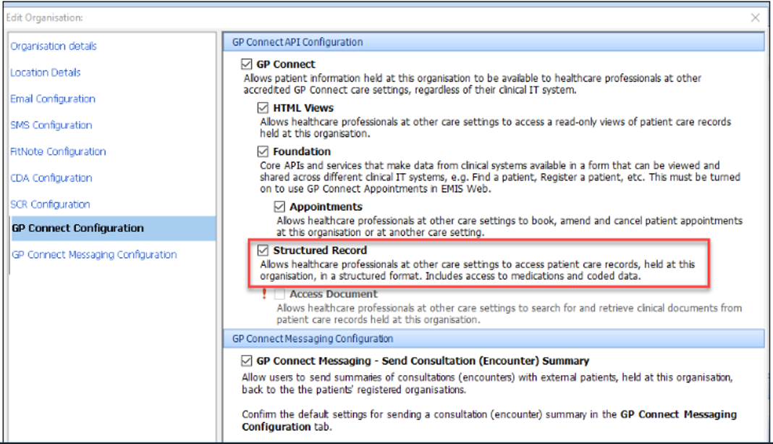
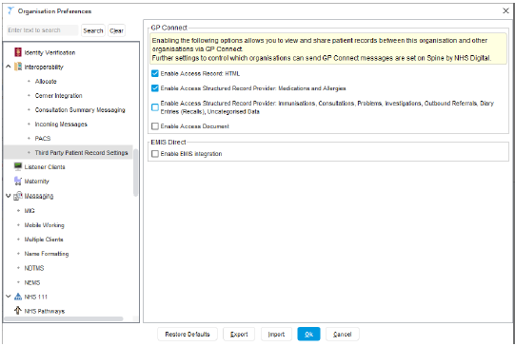
General practice configuration screens
Enabling Access Record: Structured
EMIS Web
SystmOne
EMIS Web (Optum – formerly known as EMIS)
TPP SystmOne

Slide 31
Information for community pharmacy
GP Connect Access Record: Structured

Slide 32
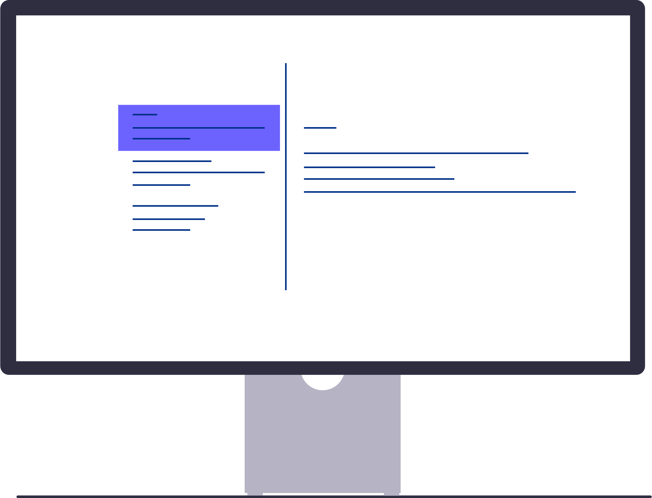



Process for accessing clinical patient information through Access Record: Structured
Medications
View patient record
Investigations
Observations items
Registered community pharmacy professionals can view the patient record directly within the consultation page.
Role-based access controls, no Smartcard required.
No need to copy and paste patient details, such as the NHS number, between systems.
Registered community pharmacy professionals will have access to three clinical areas of the patient’s GP record: medications, investigations, and observations.
Continue to use National Care Records Service/Summary Care Record for allergy information
A registered community pharmacy professional may need to review the patient’s health information, such as current and past medications, for a consultation.
If a general practice has Access Record: Structured turned off, the community pharmacy will see an error message.
If a patient has requested their patient GP record is not shared, the community pharmacy will see an error message.
In these instances, community pharmacy professionals should access clinical information via alternative resources, for example NCRS/SCR and ShCR, ask the patient or call the general practice.

Slide 33
Data flow example – community pharmacy view
Community pharmacy (CP) clinical system
General practice (GP) IT system
If Access Record: Structured is ON at the GP
CP
system
Request available patient data
GP system
ON
Log in to CP system
Patient
seen by CP
CP professional needs to access record info
Patient data available
Error message sent if patient has opted out of GP Connect
Log in to CP system
CP
system
Request available patient data
GP system
OFF
If Access Record: Structured is OFF at the GP
Patient
seen by CP
CP professional needs to access record info
Data not available – error message sent (or if patient has opted out of GP Connect)
May need to contact general practice for more information
NCRS/
ShCR
Use alternative sources

Slide 34



Accessible patient data
Access Record: Structured has started to roll out to community pharmacy for three areas of the patient’s GP record:
    Medications
    Observation items – weight, height, body mass index, pulse rate, smoking status, alcohol intake and blood pressure readings
    Investigations
Information will only flow to community pharmacy if the system in enabled with the GP IT system and the patient has not withdrawn their consent.
Changes to the GP Contract in 2025/26
The Department of Health and Social Care (DHSC) and NHS England consulted with the profession on changes to the GP contract for 25/26. The agreed changes are set out in the contract announcement letter which includes a requirement (para 8) on general practices to ensure the functionality in GP Connect (Access Record: HTML, Access Record: Structured and Update Record: Structured) is enabled by 1 October 2025.

Slide 35
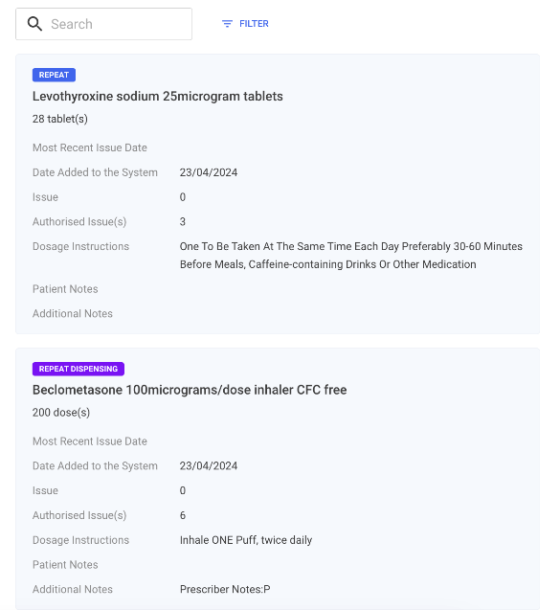
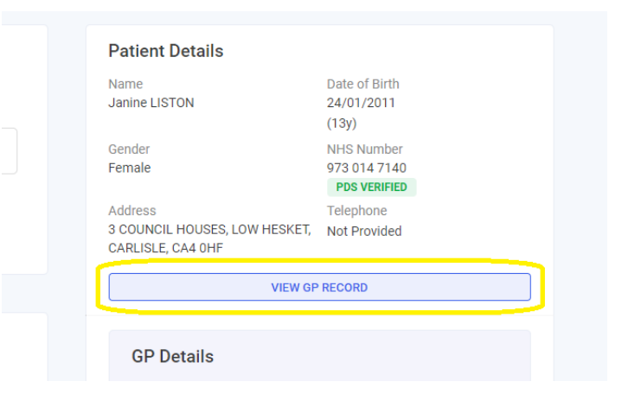
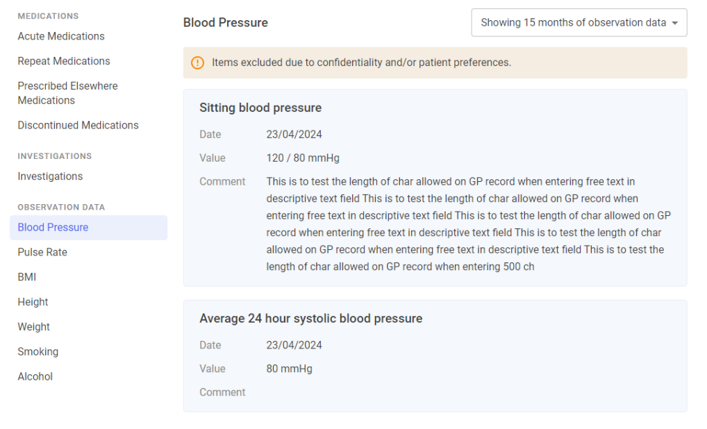
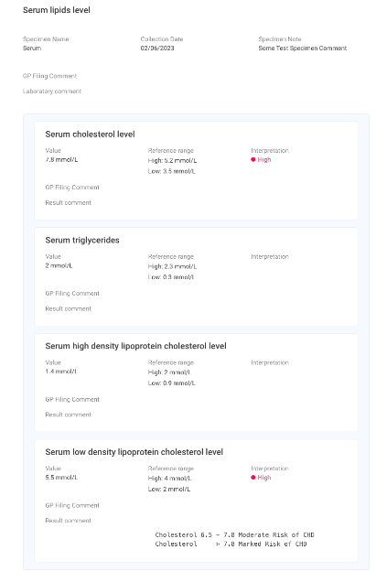
An example of what community pharmacy will see
      Zoom in to view in more detail
Integrated within pharmacy system at the point of consultation
The initial view will display data from the past 15 months, but it can be extended to show all available data
Please note, this example is from a pilot site using Cegedim Rx. User views will vary between
different supplier's systems - Cegedim Rx GP Connect Access Record: Structured
Examples view of medications and investigations

Slide 36
Updating the patient’s GP record
GP Connect Update Record: Structured
Notes:
Standard title slide

Slide 37
GP Connect Update Record: Structured
Allows registered community pharmacy professionals to send pharmacy consultation summaries in a structured format, including details of any medicines supplied. This goes directly into general practice workflows for filing, rather than via NHSmail or letter.
Been technically and clinically assured for use between registered community pharmacy professionals* and general practice and can only be used for three services:
NHS Pharmacy First Service
NHS Community Pharmacy Blood Pressure Check Service
NHS Pharmacy Contraception Service
Not used for community pharmacy to communicate urgent actions, referrals or safeguarding concerns to general practice. Community pharmacy will continue to communicate urgent actions or referrals directly to general practice following local processes, for example NHSmail or telephone.
Designed to make it easier for general practices and their teams to support the safe, accurate and timely update of patient GP records.
      More information is available at:
      GP Connect: Update Record: Structured - NHS England Digital
* Pharmacists and Pharmacy Technicians (General Pharmaceutical Council registered clinical professionals)

Slide 38
Benefits of GP Connect Update Record: Structured
General practice
Patients
Saves administrative time
Less time managing, transcribing and processing information from NHSmail and letters for general practice staff
User friendly
Community pharmacy consultations are shared with general practice in a structured format, making it quick and easy to review
Trusted communication
Update Record is clinically and technically assured and only for communication between community pharmacies and general practice
Faster information sharing
Faster access to patient information in general practice
Patient safety
General practice have access to the accurate, up to date information for patient care, reducing the risk of over prescribing and improving clinical decision-making
Patient-centric care
With updates visible in the NHS App and other patient-facing services, patients have a clearer understanding of their care journey, increasing trust and transparency.

Slide 39

Case study GP Connect Update Record: Structured in general practice (page 1 of 3)
Pharmacy First
The general practice team are trained ‘care navigators’ and refer patients, whenever possible, to community pharmacy if they meet the age and condition criteria.
It takes time to refer to a pharmacy, but they see the benefit as saving that 10-minute GP appointment slot for those that really need to see a GP.
They refer digitally through the practice IT system, as this enables the pharmacist to be better informed by receiving the patient’s NHS number and the reason for the referral.
Engagement
Work closely with the local pharmacists and meet regularly to discuss what’s working well and what can be improved to help make best use of the service for the patients.
"If the summaries come straight in as tasks, they are picked up and actioned much more quickly”
About the practice
Practice size: 16,000 patients, 5 GPs
Demographic: Suburban location with deprived patient population
Admin team size: 6 reception staff and 4 admin office staff
GP Connect: Update Record: Switched on

Slide 40

Case study GP Connect Update Record: Structured in general practice (page 2 of 3)
Pharmacy First summaries by email
GP Connect: Update Record
Current process: summaries sent directly to the system workflow
Decided to trial GP Connect: Update Record for 2 weeks and made the decision to continue, based on the benefits it brought
All Pharmacy First consultation summaries now come directly into the IT system workflow, within half an hour of the patient’s consultation
As the summary comes into the workflow, it can be picked up straightaway, reviewed and filed
No attachments – all details easily viewable in the record
Already matched to the patient – no admin effort
Pharmacy details included
Condition treated included – no manual coding
Medications prescribed or supplied show automatically in the medications tab
Just need to review and file/save
Patient can see the summary details in the NHS App once approved by their GP
Previous process for managing Pharmacy First summaries
The practice received many Pharmacy First patient updates each day and they wanted to make sure patient records were updated as soon as possible.
They had a target of 48 hours to add care details to records, but would like to do this more quickly.
Pharmacy First summaries came into the practice NHSmail inbox, which was monitored regularly, but not constantly throughout the day. This could cause delays in the time taken for patient information to be added to the record.
They would print the emailed pharmacy consultation summary, place it in a filing tray to be scanned, coded and then filed in the patient’s GP record.
This process could take up to 3 days to complete and could take longer if there were staff absences.

Slide 41

Case study GP Connect Update Record: Structured in general practice (page 3 of 3)
In their words
“It’s miles quicker! [Previously] we were reliant on someone picking up the email and adding it to Docman and that could take up to 48 hours depending on staffing”
"The ones that come into the workflow, they're dead easy for us and save a lot of time, because it's already matched to the patient. Everything's already been entered. We just double check the details match and file it"
“If a patient has been seen by the pharmacy, we get a document into workflow manager. Go into ‘consultations’ and everything's come through and been coded. The medications are in the medications tab. All we have to do, which is great, is just press file”
“If they come straight in as tasks, they’re picked up and actioned much more quickly”

Slide 42
Information for general practice
GP Connect Update Record: Structured

Slide 43




GP Connect Update Record: Structured
Community pharmacy consultation summaries (including observations, notes and any medicines supplied) arrive in the general practice workflow in GP IT systems for filing in the patient’s GP record.
A workflow task is created in the GP IT system for every community pharmacy consultation summary received, so it is visible to the practice before filing into the patient’s GP record with one click.
As part of the Pharmacy Contraception Service the community pharmacy team will capture consent that the patient is happy to share details of the consultation with their GP practice.
Patients will be made aware that a consultation summary and any medicines supplied may be visible in NHS App and other patient-facing services, where this has been enabled by the practice. In the case of contraception consultations, a patient can choose to not have this information shared.
As clinical healthcare professionals, registered community pharmacy professionals have full responsibility for ensuring that any medicines supplied are clinically appropriate. GPs are not responsible for management and treatment decisions including any medicines supplied by registered community pharmacy professionals.
In the vast majority of cases, patients will not require ongoing treatment or monitoring by GPs following a community pharmacy consultation. The specification for each of the services delivered through community pharmacy sets out guidelines for escalation and onward referral where clinically appropriate.

Slide 44












What is sent as part of GP Connect Update Record: Structured?
GP Connect Update Record: Structured is used for the Pharmacy First Clinical Pathways and Minor Illness Service, Blood Pressure Check Service, and Pharmacy Contraception Service.
Information sent will include:
Person demographics and general practice details
Clinical summary of consultation
Date and time of consultation
Observations e.g., blood pressure and temperature
Pharmacy details
Pregnancy status
Outcome of consultation
Medicine details or reasons for no supply
Clinician details
Information and advice given to the patient
Presenting complaint
Signposting information

Slide 45

What is not sent as part of GP Connect Update Record: Structured?
Is not used to communicate urgent actions or referrals
Where urgent action or an urgent referral to general practice is required, the pharmacist must communicate directly, following local processes e.g., NHSmail or telephone.
Is not used to communicate safeguarding concerns
Where a safeguarding concern is identified, follow local safeguarding procedures.
In the case of contraception consultations, a patient can choose not to have this shared with the GP
The community pharmacy registered professional should capture in the pharmacy consultation record that the patient does not consent to the information being shared with general practice. The community pharmacy IT system won’t share where non-consent has been recorded.

Slide 46

Enabling GP Connect Update Record: Structured
If a general practice has GP Connect Update Record: Structured turned off, the community pharmacy must send the consultation summary via NHSmail or letter for the practice to manually transcribe into the GP patient record.
GP practices using Optum’s EMIS Web or TPP’s SystmOne need to follow the steps below to enable Update Record: Structured.
EMIS Web
SystmOne
EMIS button > Configuration > Organisation Configuration
Select Organisation (make sure practice is correct) > Edit
Select Organisation Details > Scroll down to option for Accept GP Connect Update Record via Mesh
Select Yes
Setup > Users + Policy > Organisation Preferences
Scroll down to Interoperability > Select the arrow to open up options
Select Incoming Messages
For turning on select
File automatically from within GP Connect Update Record Messages (default)
Or Create Task for Manual Filing (this will require a user to view and accept the summary data before it is added to the patient)
EMIS Web (Optum – formerly known as EMIS)
TPP SystmOne
Changes to the GP Contract in 2025/26 - The Department of Health and Social Care (DHSC) and NHS England consulted with the profession on changes to the GP contract for 25/26. The agreed changes are set out in the contract announcement letter which includes a requirement (para 8) on general practices to ensure the functionality in GP Connect (Access Record: HTML, Access Record: Structured and Update Record: Structured) is enabled by 1 October 2025.

Slide 47
Data controller responsibilities for general practice
GP Connect Update Record: Structured has not changed the general practice’s data controller role or responsibilities.
General practice
Community pharmacy
General practice are responsible for the data in the patient’s GP record.
Update Record: Structured presents the community pharmacy consultation summary in the practice workflow ready for it to be added to the patient’s GP record.
It is only when the data has been added to the patient GP record that the GP becomes responsible for the data.
The details of the community pharmacy where the consultation took place and the name of the clinician that the patient was seen by is in the message and clearly visible in the patient record.
Community pharmacy businesses are responsible for the data generated as part of the patient consultation.
NHS England
NHS England is responsible for the safe and secure transit of data between care settings

Slide 48
Information for community pharmacy
GP Connect Update Record: Structured

Slide 49



GP Connect Update Record: Structured
Community pharmacies do not need to take any action to implement GP Connect Update Record: Structured and will not notice any changes to the user interface. Community pharmacy professionals should continue to record and submit consultation summaries into their clinical IT system in the usual way.
GP Connect Update Record: Structured is designed to reduce the admin burden for community pharmacy staff having to send consultation summaries via NHSmail or letter.
Consultation summaries and medicines may fail to send via Update Record: Structured if the GP IT system is not working or the GP practice has not enabled Update Record: Structured. Community pharmacy must send the consultation summary via NHSmail or letter in accordance with their IT system processes in such cases.
Community pharmacy must communicate urgent actions or referrals directly with the patient’s GP following local processes, for example NHSmail or telephone. Update Record: Structured only provides the summary of the community pharmacy consultation, it must not be used to communicate actions or referrals to general practice.
Registered community pharmacy professionals must follow local safeguarding procedures where they have a safeguarding concern. Update Record: Structured must not be used to communicate safeguarding concerns.

Slide 50
What is sent as part of GP Connect Update Record: Structured?
GP Connect Update Record: Structured is used for the Pharmacy First Clinical Pathways and Minor Illness Service, Blood Pressure Check Service, and Pharmacy Contraception Service.
Information sent will include:
Person demographics and general practice details
Clinical summary of consultation
Date and time of consultation
Observations e.g., blood pressure and temperature
Pharmacy details
Pregnancy status
Outcome of consultation
Medicine details or reasons for no supply
Clinician details
Information and advice given to the patient
Presenting complaint
Signposting information

Slide 51


What is not sent as part of GP Connect Update Record: Structured?
Is not used to communicate urgent actions or referrals
Where urgent action or an urgent referral to general practice is required, this must be communicated directly, following local processes e.g., NHSmail or telephone.
Is not used to communicate safeguarding concerns
Where a safeguarding concern is identified, follow local safeguarding procedures.
Pharmacy Contraception Service. In the case of contraception consultations, a patient can choose not to have this shared with the GP
The community pharmacy registered professional must capture patient consent to share details of the consultation with their GP. Patients should be made aware that a consultation summary and any medicines supplied may be visible in the NHS App and other patient-facing services where this has been enabled by the practice.
In these cases, the community pharmacy professional should capture in the pharmacy consultation record that the patient does not consent to the information being shared with general practice.

Slide 52
Data controller responsibilities for community pharmacy
GP Connect Update Record: Structured has not changed community pharmacy data controller role or responsibilities.
Community pharmacy
General practice
Community pharmacy businesses are responsible for the data generated as part of the patient consultation.
General practice are responsible for the data in the patient’s GP record.
Update Record: Structured presents the community pharmacy consultation summary in the practice workflow ready for it to be added to the patient’s GP record.
It is only when the data has been added to the patient GP record that the GP becomes responsible for the data.
The details of the community pharmacy where the consultation took place and the name of the clinician that the patient was seen by is in the message and clearly visible in the patient record.
NHS England
NHS England is responsible for the safe and secure transit of data between care settings

Slide 53


Observations and SNOMED CT
Using digital standards, community pharmacies can record referred patient's observations and treatments and share vital information about a person’s care with GP practices.
Please refer to the Community Pharmacy Standard – PRSB v3.01.03, released September 2023.
  NHSE clinical leads together with terminology specialists and SNOMED team agreed the recommended list of SNOMED codes to be used for the Pharmacy First UR payloads. This was primarily developed to support system suppliers.
  Endorsed by several professional representation bodies incl. RCGP.
The recommended codes were included based on clinical appropriateness and how commonly they are used in general practice. GP IT suppliers were consulted in some cases e.g. ABPM readings

Slide 54
Managing digital live service issues
Notes:
Standard title slide

Slide 55




Managing digital live service issues
General practice or community pharmacies should report any digital or technical issues directly with suppliers.
The supplier will either:
Support a local resolution
Fix the issue themselves in their back office, or
Escalate to NHS England, using agreed and well tested protocols
ICBs and regions with their own IT support hub should follow local procedures, with escalations being to suppliers
Standard way of reporting live service issues to NHSE via suppliers that:
Ensures fast, responsive support
Provides regular updates for high impact issues
Enables us to triage the issue and provide the right level of expertise
Suppliers understand and use regularly
Has 24/7/365 cover

Slide 56
Links
Notes:
Standard title slide

Slide 57
Useful links
NHS Pharmacy First Service
NHS England » Pharmacy First
NHS Pharmacy Contraception Service
NHS England » NHS Pharmacy Contraception Service
NHS Community Pharmacy Blood Pressure Check Service
NHS England » NHS Blood Pressure Check Service
Advanced service specification: NHS community pharmacy hypertension case-finding advanced service (NHS community pharmacy blood pressure check service)
Booking and Referral Standard
Booking and Referral Standard - NHS England Digital
GP Connect
GP Connect - NHS England Digital
Sign the National Data Sharing Arrangement - National Data Sharing Portal
National Data Sharing Arrangement for GP Connect - NHS England Digital
Search by Organisation Name - National Data Sharing Portal for GP Connect
Access Record: Structured
GP Connect: Access Record - NHS England Digital
Update Record: Structured
GP Connect: Update Record - NHS England Digital
Data
Dispensing contractors' data | NHSBSA
Changes to the GP Contract in 2025/26
NHS England » Changes to the GP Contract in 2025/26
Suppliers – for further information and guidance
Cegedim Rx (previously known as Cegedim Healthcare Solutions)
Cegedim Pharmacy Solutions
Cegedim Pharmacy Solutions Help Centre
GP Connect: Access Record
Optum (previously known as EMIS)
Optum UK - Healthcare Solutions & Services
PharmOutcomes
Product | PharmOutcomes | Optum
EMIS Web
System | EMIS Web | EMIS
Positive Solutions
Positive Solutions | Intelligent Healthcare Technology
Sonar Health
Home - SonarHealth
TPP SystmOne
TPP

